Slide 1
CRISPR-Screen Update
David Chen

Slide 2
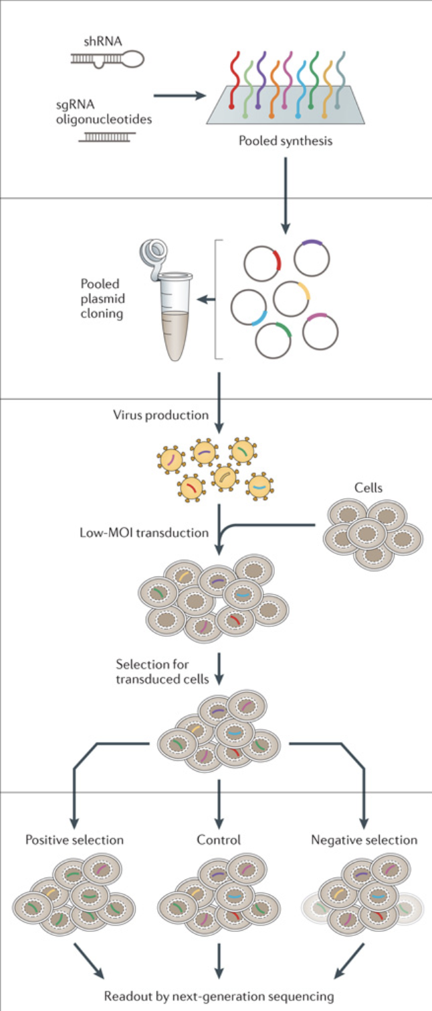
Introduction
Methods
Results
Discussion
Conclusion
Pooled CRISPR Screens
In pooled screens, reagents are usually synthesized and constructed as a pool.
Viral transduction limits transgene copy number (ideally, one perturbation per cell),
Viral integration enables readout through PCR and next-generation sequencing
Readout is based on the comparison of the abundance of the different genomically integrated transgene reagents between samples.
Figured sourced from Shalem et al. 2015

Slide 3
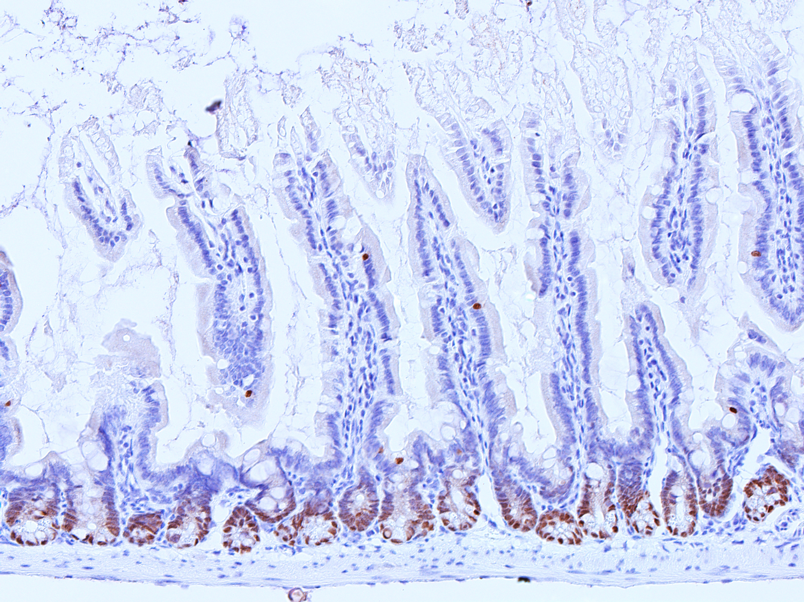
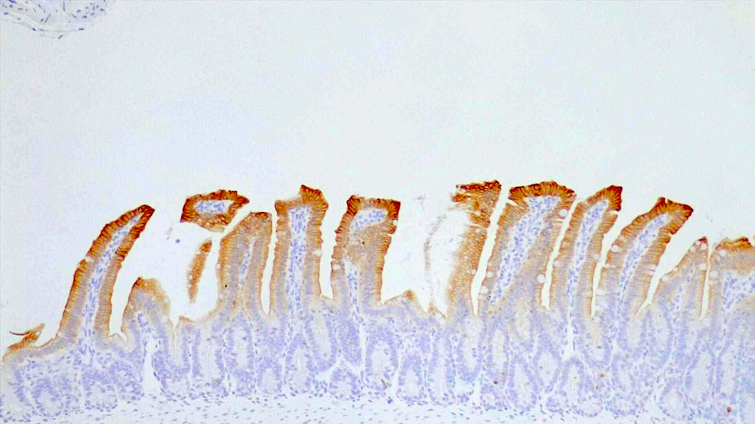
Introduction
Methods
Results
Discussion
Conclusion
Regenerative tissue homeostasis: stem cell ↔ differentiation balance
BMP
Lumen
Differentiate
Villus
Stem cell
Crypt
Sox9 IHC
Krt20 IHC
WNT

Slide 4

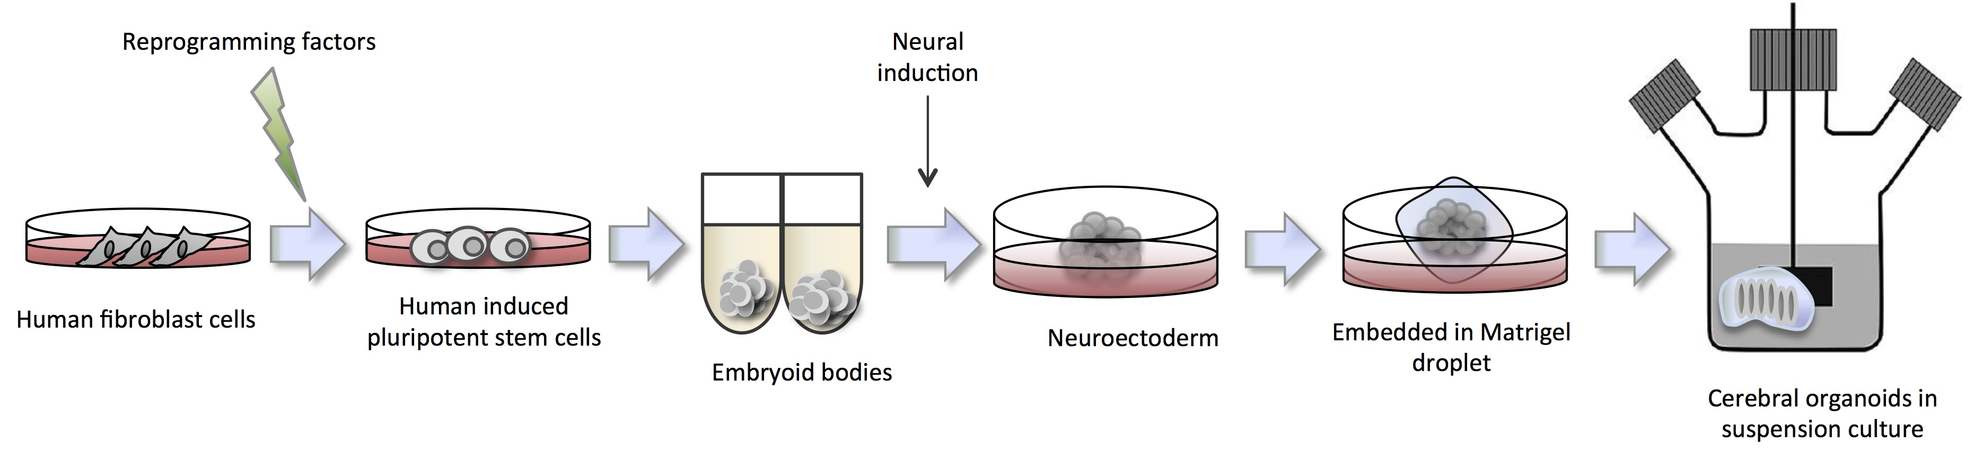
Introduction
Methods
Results
Discussion
Conclusion
Endogenous stem cell and differentiation reporter system
T2A
GFP
Neo
T2A
K2
Blast
SOX9
KRT20
Stem Cell Reporter
System
Differentiation Reporter
System
Aims
Understanding of stem cell and differentiation program in CRC
Find therapeutic vulnerabilities
A
OPTIMIZATION
B
GENETIC SCREEN
T2A
GFP
Neo
Engineer
Stem Cell
Gene
CRISPR Library
CRC Reporter
Cell Lines
GFP+
K2+
GFP-
Validate
Mini-Screen
Readout
Validate

Slide 5
Introduction
Methods
Results
Discussion
Conclusion
Stem cell reporter system mini-screen (76gRNA) results
EGFP_g1
SOX9_g1
PROM1_g1
KRT20_g1
LRIG1_g1
CTRL0001_g1
ROSA26_g1
CCR5_g1
AAVS1_g1
EGFP_g2
SOX9_g2
PROM1_g2
KRT20_g2
LRIG1_g2
CTRL0002_g2
ROSA26_g2
CCR5_g2
AAVS1_g2
EGFP_g3
SOX9_g3
PROM1_g3
KRT20_g3
LRIG1_g3
CTRL0003_g3
ROSA26_g3
CCR5_g3
AAVS1_g3
EGFP_g4
SOX9_g4
PROM1_g4
KRT20_g4
LRIG1_g4
CTRL0004_g4
ROSA26_g4
CCR5_g4
AAVS1_g4
EGFP_g5
SOX9_g5
PROM1_g5
KRT20_g5
LRIG1_g5
CTRL0005_g5
ROSA26_g5
CCR5_g5
AAVS1_g5
EGFP_g6
SOX9_g6
PROM1_g6
KRT20_g6
LRIG1_g6
CTRL0006_g6
ROSA26_g6
CCR5_g6
AAVS1_g6
Mini-Screen
(70 guides)
CTRL0007_g7
ROSA26_g7
CCR5_g7
AAVS1_g7
10⁴
Top 20%
GFP+
CTRL0008_g8
ROSA26_g8
CCR5_g8
AAVS1_g8
CTRL0009_g9
ROSA26_g9
CCR5_g9
AAVS1_g9
8
CTRL0010_g10
ROSA26_g10
CCR5_g10
AAVS1_g10
GFP
10³
Bottom
20%
GFP+
6
LS180_SOX9-T2A-
GFP
10²
GFP-
neg
Normalized
Guide Abundance
14.0%
4
10³
SSC
10⁴
2
0
TOP 20%
BOTTOM 20%
NEGATIVE

Slide 6
Introduction
Methods
Results
Discussion
Conclusion
Research Question
What is the optimal timepoint to conduct the screen (Day 3 vs. Day 7)?
What are the best fractions based on GFP intensity to compare?
What are the best analytical tools to analyze the data?
What are the best visualization methods?
Goal: Develop comprehensive pipeline based on analyzing these questions to analyze the dual reporter system
I will demonstrate my analytical pipeline using two different single knock-in (KI) cell lines:
LS180 SOX9 GFP (Primer 3 and Primer 5)
HT-29 KRT20 GFP (Primer 4 and Primer 6)

Slide 7
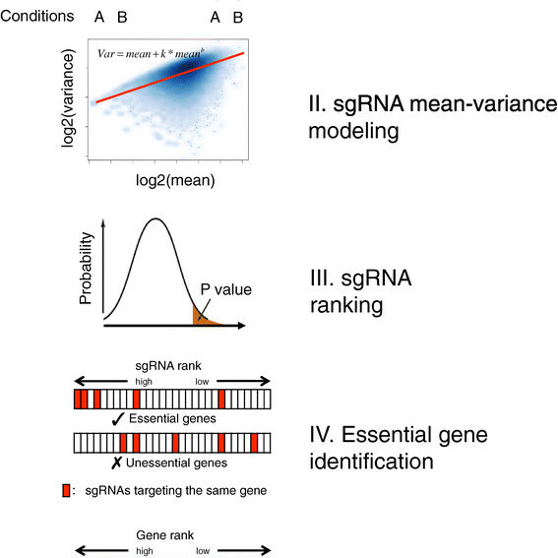
Introduction
Methods
Results
Discussion
Conclusion
Methods
Model-based Analysis of Genome-wide CRISPR/Cas9 Knockout (MAGeCK)
P values
Robust Rank Algorithm Scores
Maximum Likelihood Estimation Scores
Regression analysis
Clustering
Log fold change visualizations
Volcano plots

Slide 8
Introduction
Methods
Results
Discussion
Conclusion
Expected Results
Flow Sorting
gRNA Distribution and Ratio
LS180 SOX9 GFP
Lumen
CTRL
GFP
SOX9
Differentiated
Cells
10⁴
Top
GFP+
Villus
GFP (SOX9)
10³
Top GFP+
Bottom
GFP+
Top GFP+
Stem Cell
Program
Crypt
10²
GFP-
neg
14.0%
GFP- neg
10³
10⁴
GFP- neg
SSC
*
HT-29 KRT20 GFP
CTRL
GFP
KRT20
SOX9
Lumen
Differentiated
Cells
10⁴
Top
GFP+
Villus
GFP (KRT20)
Top GFP+
10³
Bottom
GFP+
Stem Cell
Program
10²
*
GFP-
neg
*
Crypt
*
14.0%
10³
10⁴
GFP- neg
SSC
Notes:
Expected Results:
In order to functionally validate the Reporter system, we used two different single reporter cell line. One for the stem cell program, the other for the Differentiation program.
Given the simplicity to measure single fluorescent (green) channel, we used GFP as a reporter molecule. Sorting cells based on the green intensity, we able to monitor the change of Sox9 intensity across the cell population.
This means, that cells with high GFP intensity have active stem cell program. Losing GFP intensity associates with initiation of cell differentiation.
If, we compare gRNA distribution across the different GFP intensity fractions, we see even distribution of the CTRL guide RNAs which do not influence SOX9/GFP expression. However, direct targeting of SOX9 and GFP gRNAs are depleting form the High GFP fraction.
4. and 5. Comparing the gRNA ratios between GFP+ and GFP- fraction, we expect that CTRL gRNAs align to the null line. Those gRNAs which depleting from the GFP+ fraction, we expect to enrich in the GFP – fraction.
7. We use the same gating strategy in case of the other cell line.
8. In this case, the green cells will reflect the differentiated cell population.
9. and 10. we expect the same gRNA distribution and ratio in case of the CTRL and GFP + KRT20 guides.
11. However, we know, that Sox9 blocks differentiation. Therefore, releasing it`s inhibitory effect with SOX9 specific gRNAs, we expect to see that SOX9 guides enrich in the green (differentiated) fraction.
12. We expect to see low SOX9 guide levels at the GFP- fraction and over representation in the GFP+ fraction (differentiated cells) due to the loss of SOX9 function.

Slide 9
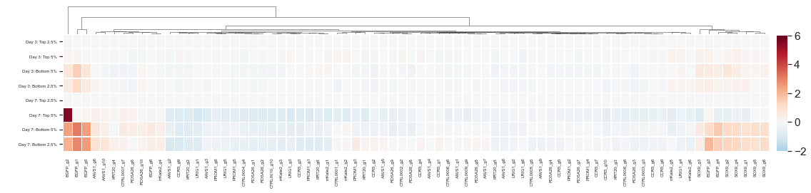
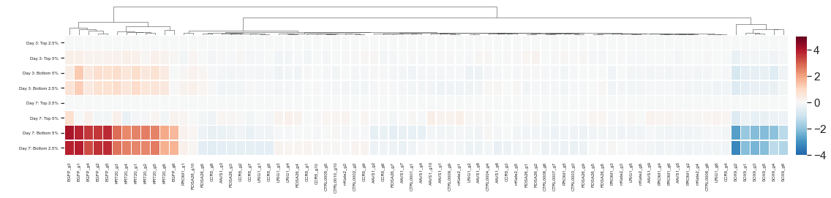
Introduction
Methods
Results
Discussion
Conclusion
LFC Heatmap of HT-29 KRT20 GFP and LS180 SOX9 GFP
Day 3: Top 2.5%
Day 3: Top 5%
Day 3: Bottom 5%
Day 3: Bottom 2.5%
Day 7: Top 2.5%
Day 7: Top 5%
Day 7: Bottom 5%
Day 7: Bottom 2.5%
Primer 3: LS180 SOX9 GFP
Day 3
Day 7
Primer 4: HT-29 KRT20 GFP
Notes:
LS180 SOX9 GFP
-Enrichment of GFP and SOX9 gRNA in Bottom Fraction compared to Top Fraction (depletion from Top Fraction)
-Bottom 5% Fraction with lower GFP intensity has enrichment of SOX9 and GFP gRNA counts
-Less active stem cell program in bottom fraction
HT-29 KRT20 GFP
-Enrichment of GFP and KRT20 gRNA in Bottom Fraction compared to Top Fraction (depletion from Top Fraction)
-Depletion of SOX9 in Bottom Fraction compared to Top Fraction (enrichment in Top Fraction)
-Bottom 5% Fraction with lower GFP intensity has enrichment of KRT20 and GFP gRNA counts
-Bottom 5% Fraction with lower GFP intensity has depletion of SOX9 gRNA counts
-More active stem cell program in bottom fraction

Slide 10
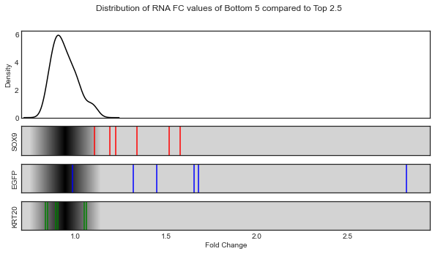
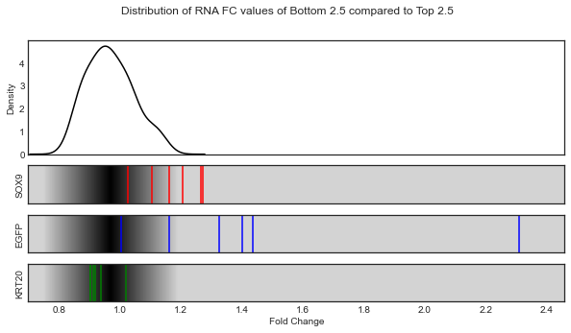
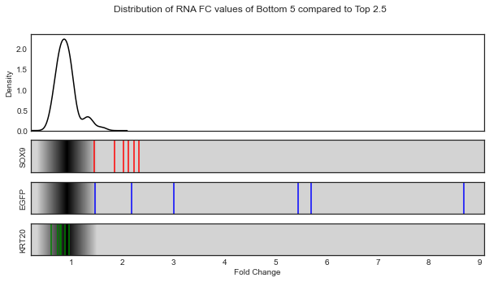
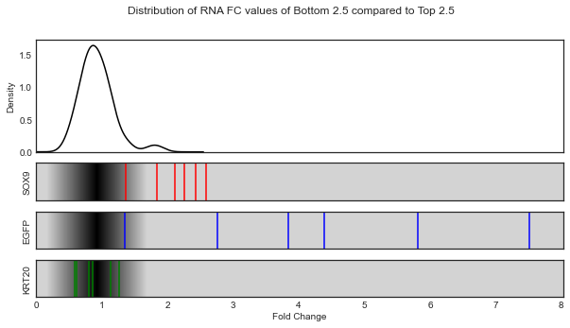
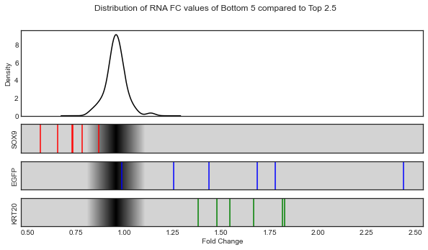
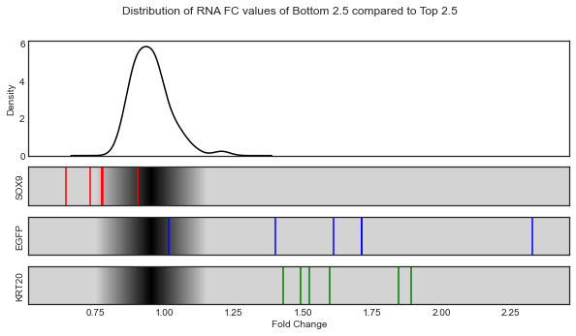
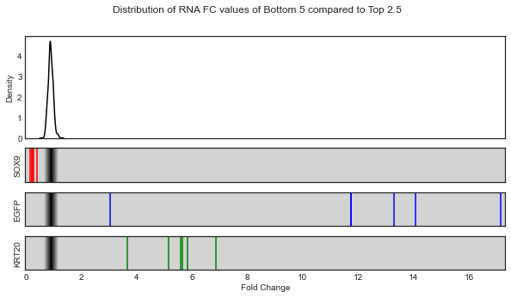
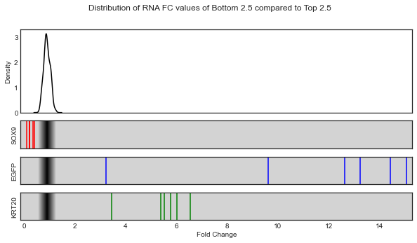
Introduction
Methods
Results
Discussion
Conclusion
FC Density Plot of HT-29 KRT20 GFP and LS180 SOX9 GFP
Day 3
Day 7
Bottom 5%
Bottom 2.5%
Bottom 5%
Bottom 2.5%
Primer 3: LS180 SOX9 GFP
Primer 4: HT-29 KRT20 GFP

Slide 11
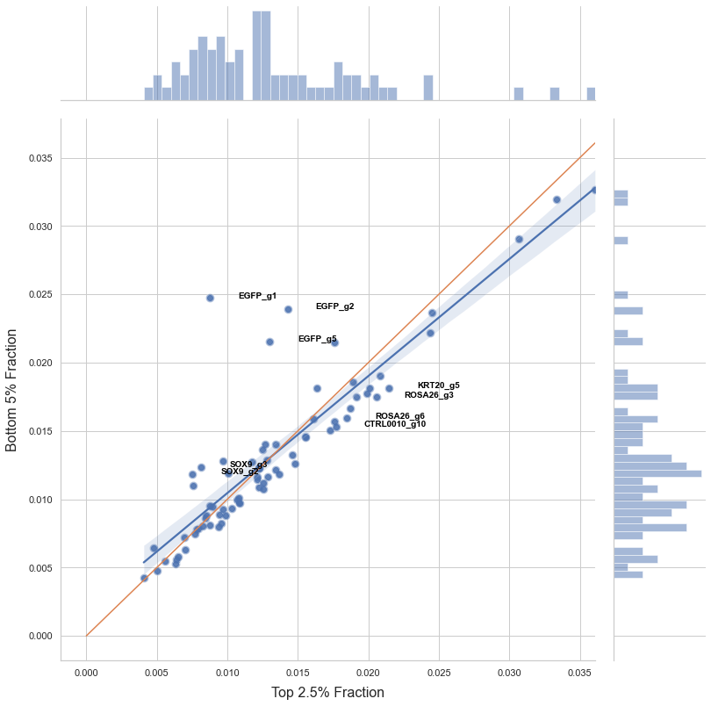
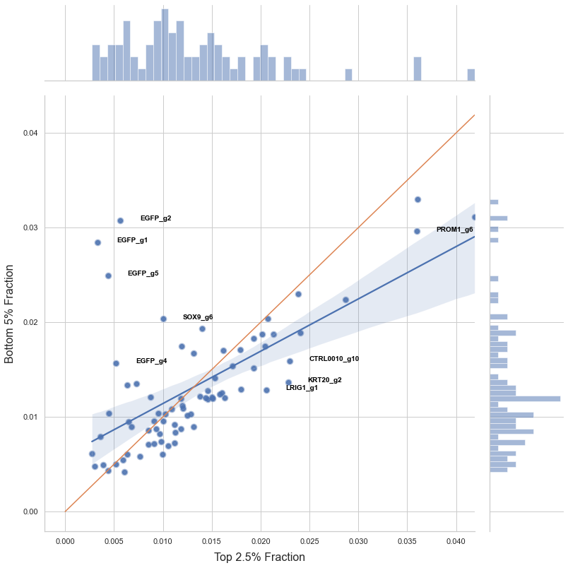
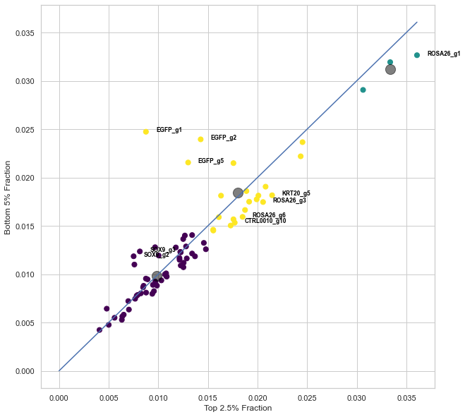
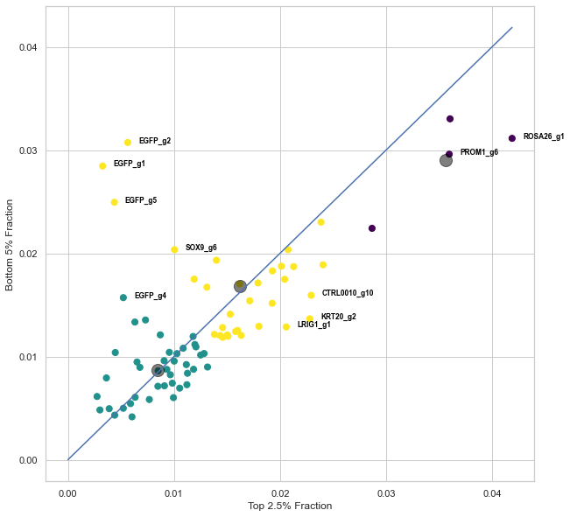
Introduction
Methods
Results
Discussion
Conclusion
Primer 3: LS180 SOX9 GFP
Top 2.5% vs Bottom 5%
Day 3
Day 7

Slide 12
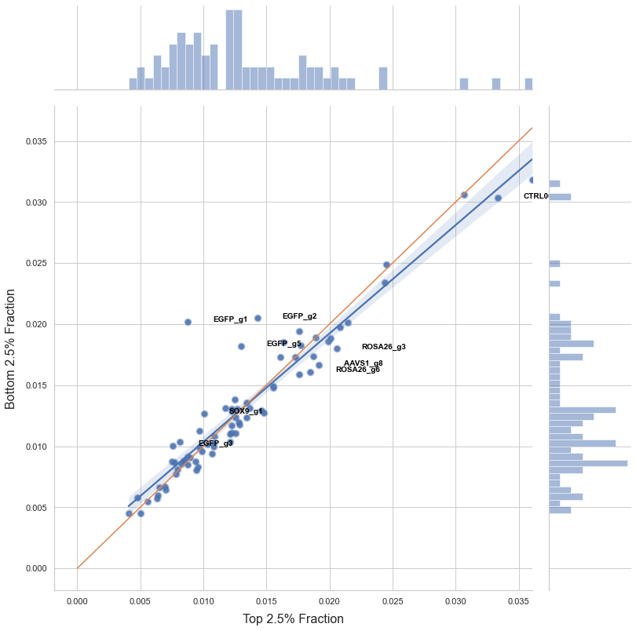
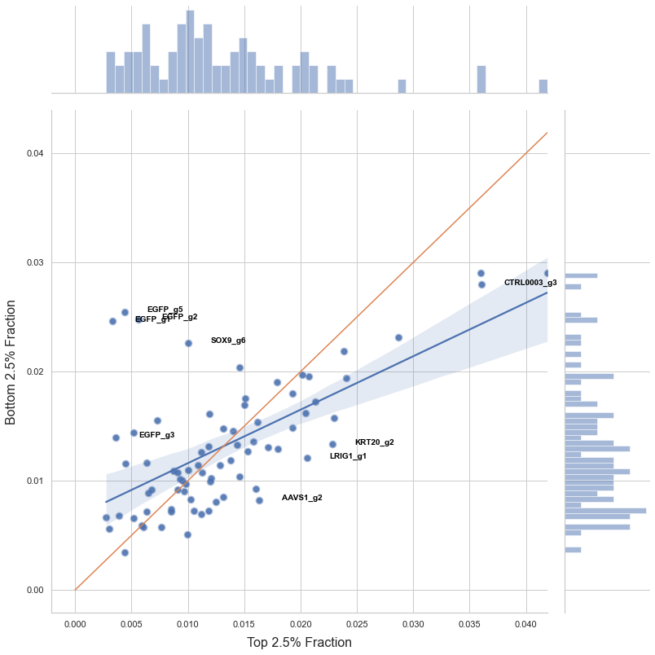
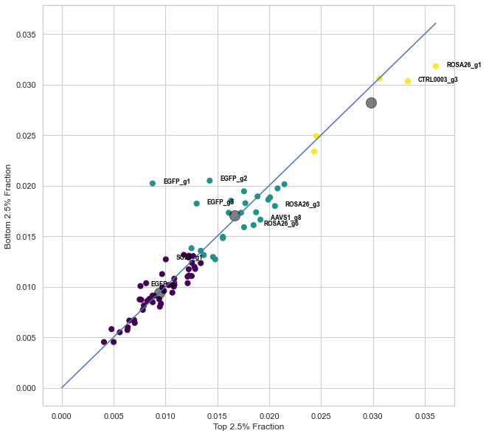
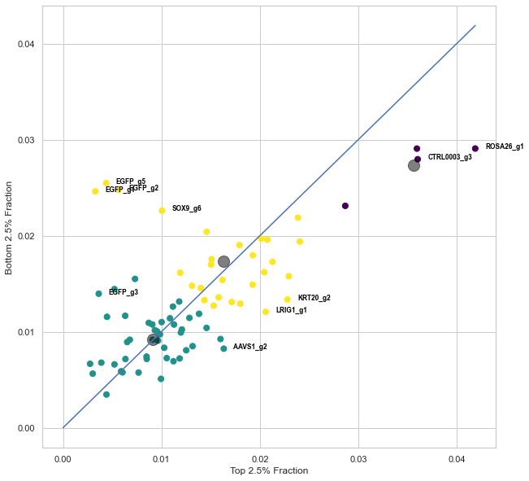
Introduction
Methods
Results
Discussion
Conclusion
Primer 3: LS180 SOX9 GFP
Top 2.5% vs Bottom 2.5%
Day 3
Day 7

Slide 13
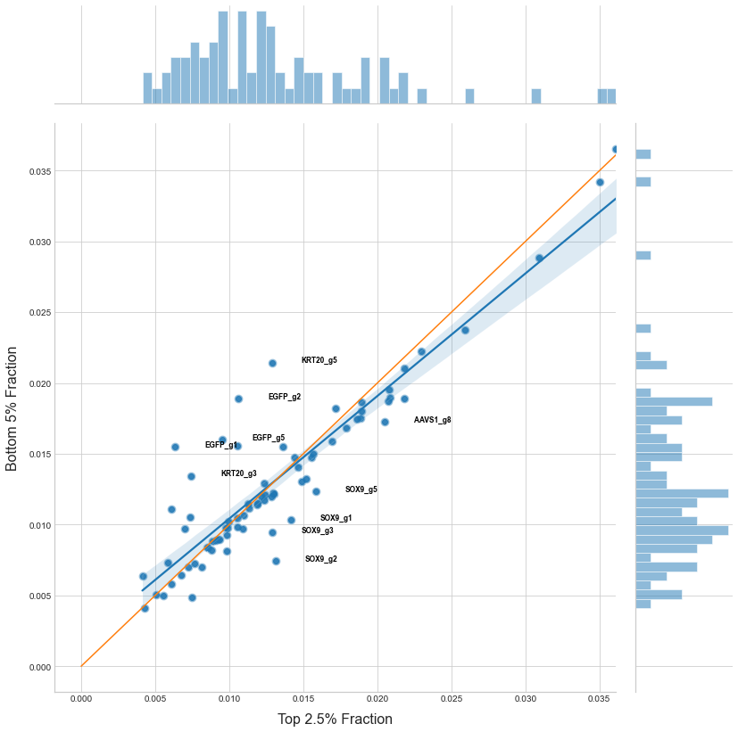
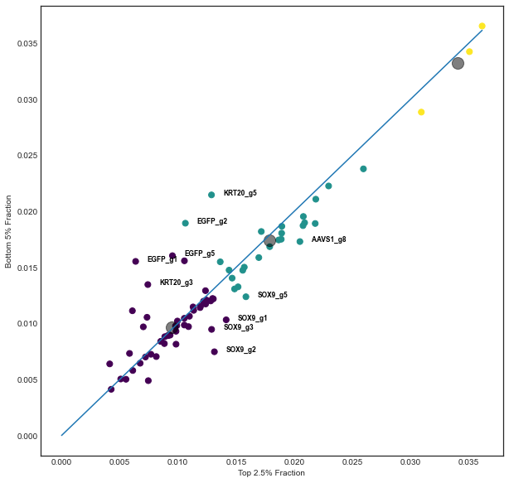
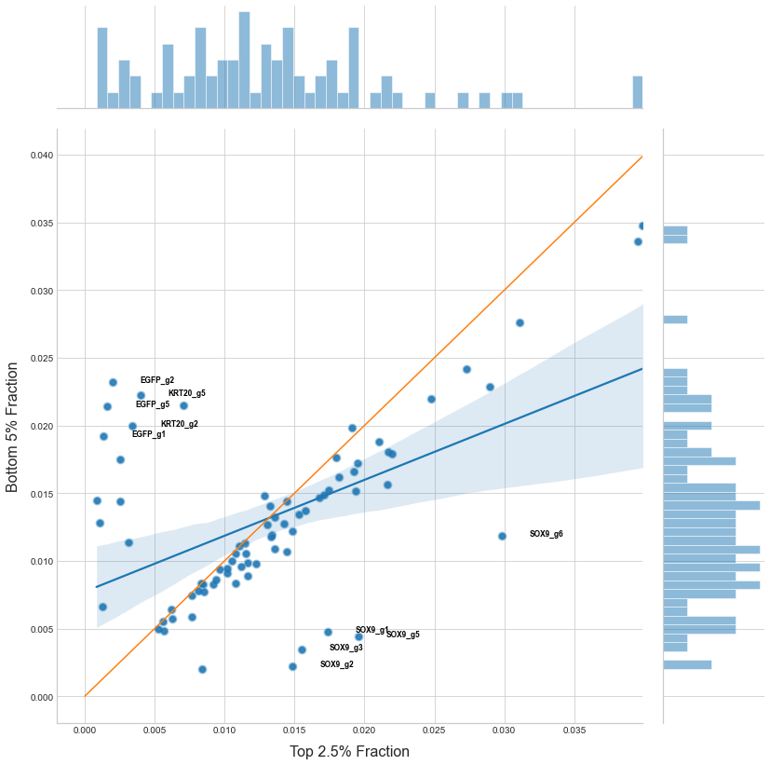
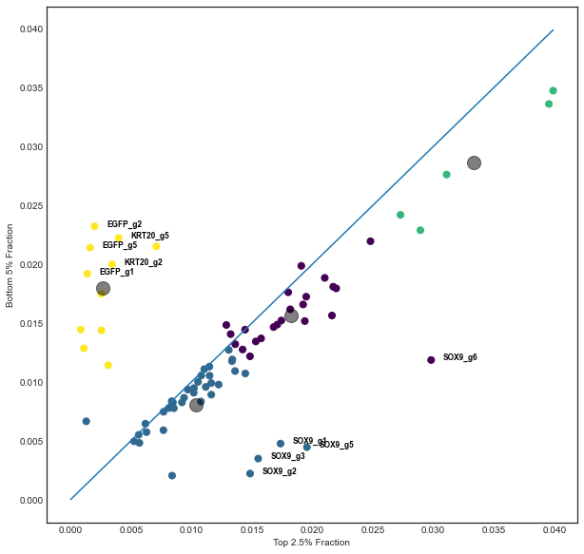
Introduction
Methods
Results
Discussion
Conclusion
Primer 4: HT-29 KRT20 GFP
Top 2.5% vs Bottom 5%
Day 3
Day 7

Slide 14
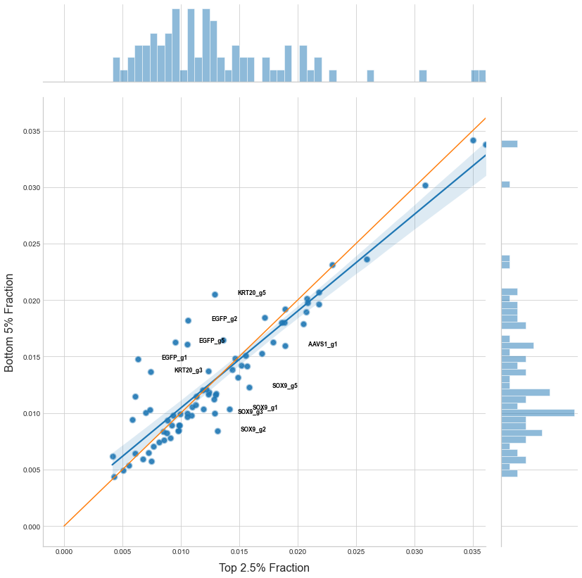
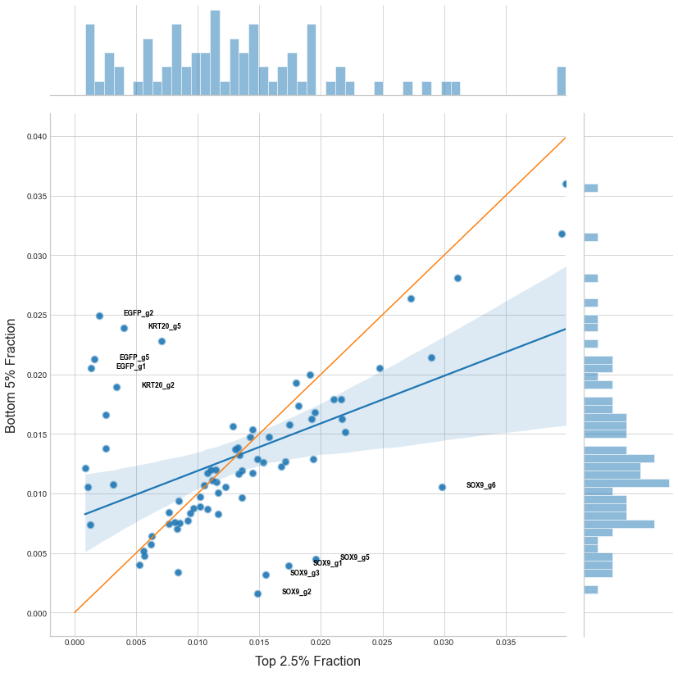
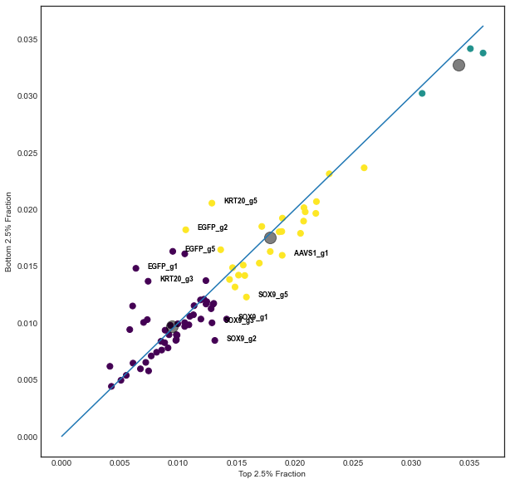
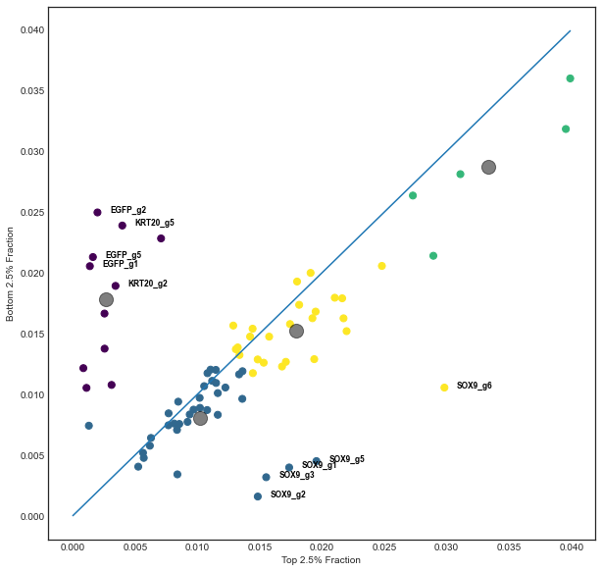
Introduction
Methods
Results
Discussion
Conclusion
Primer 4: HT-29 KRT20 GFP
Top 2.5% vs Bottom 2.5%
Day 3
Day 7

Slide 15
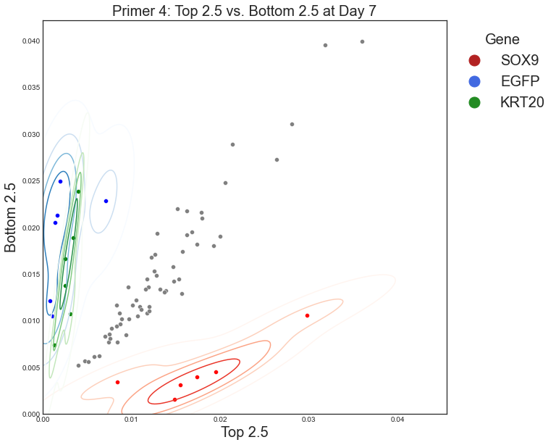
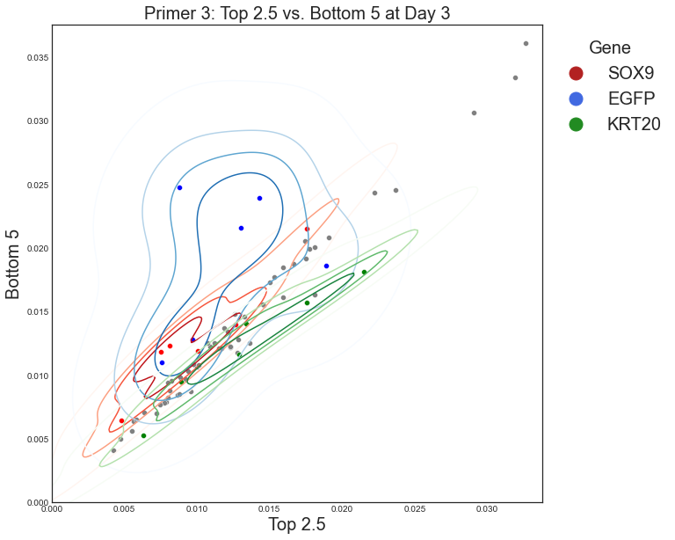
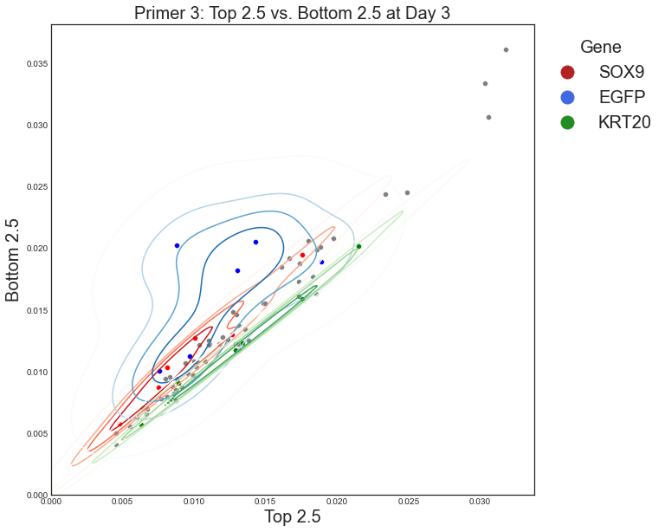
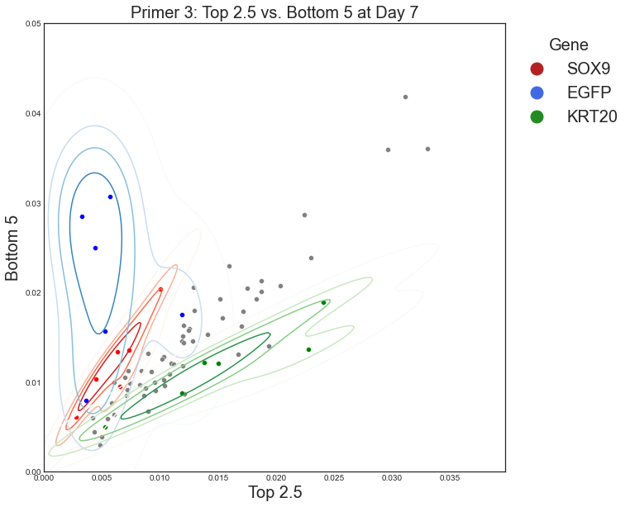
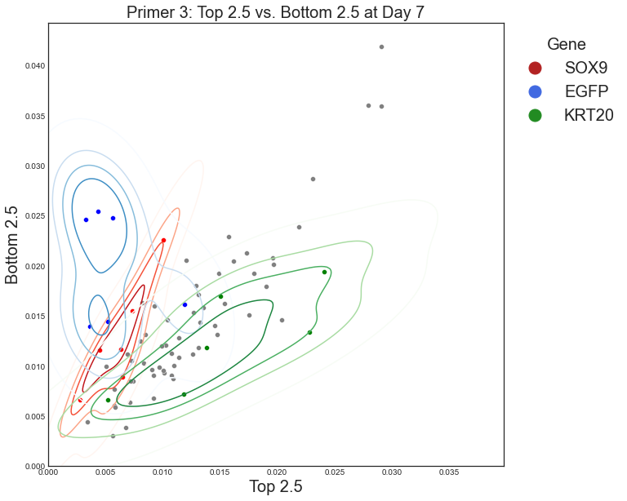
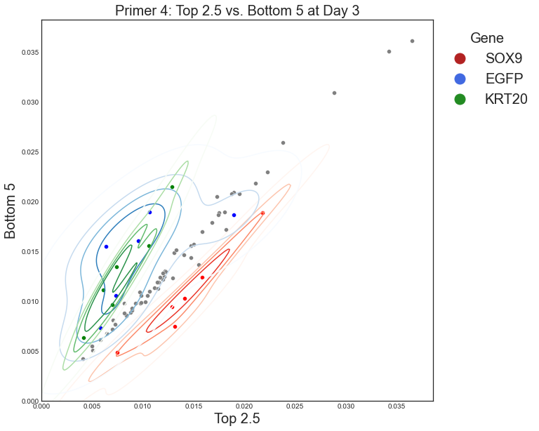
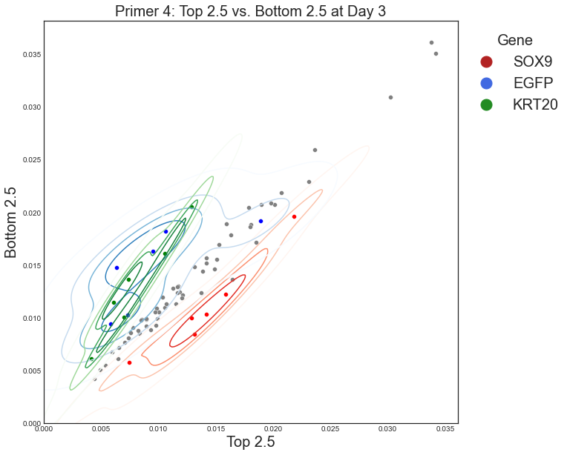
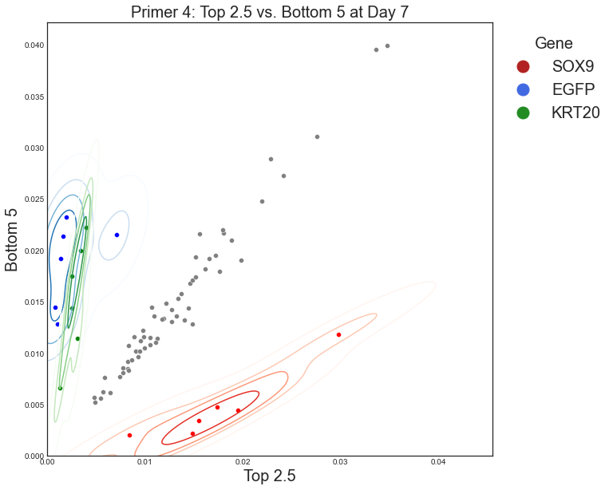
Introduction
Methods
Results
Discussion
Conclusion
KDE Plot of HT-29 KRT20 GFP and LS180 SOX9 GFP
Day 3
Day 7
Bottom 5%
Bottom 2.5%
Bottom 5%
Bottom 2.5%
Primer 3:
LS180 SOX9 GFP
Primer 4:
HT-29 KRT20 GFP
*

Slide 16
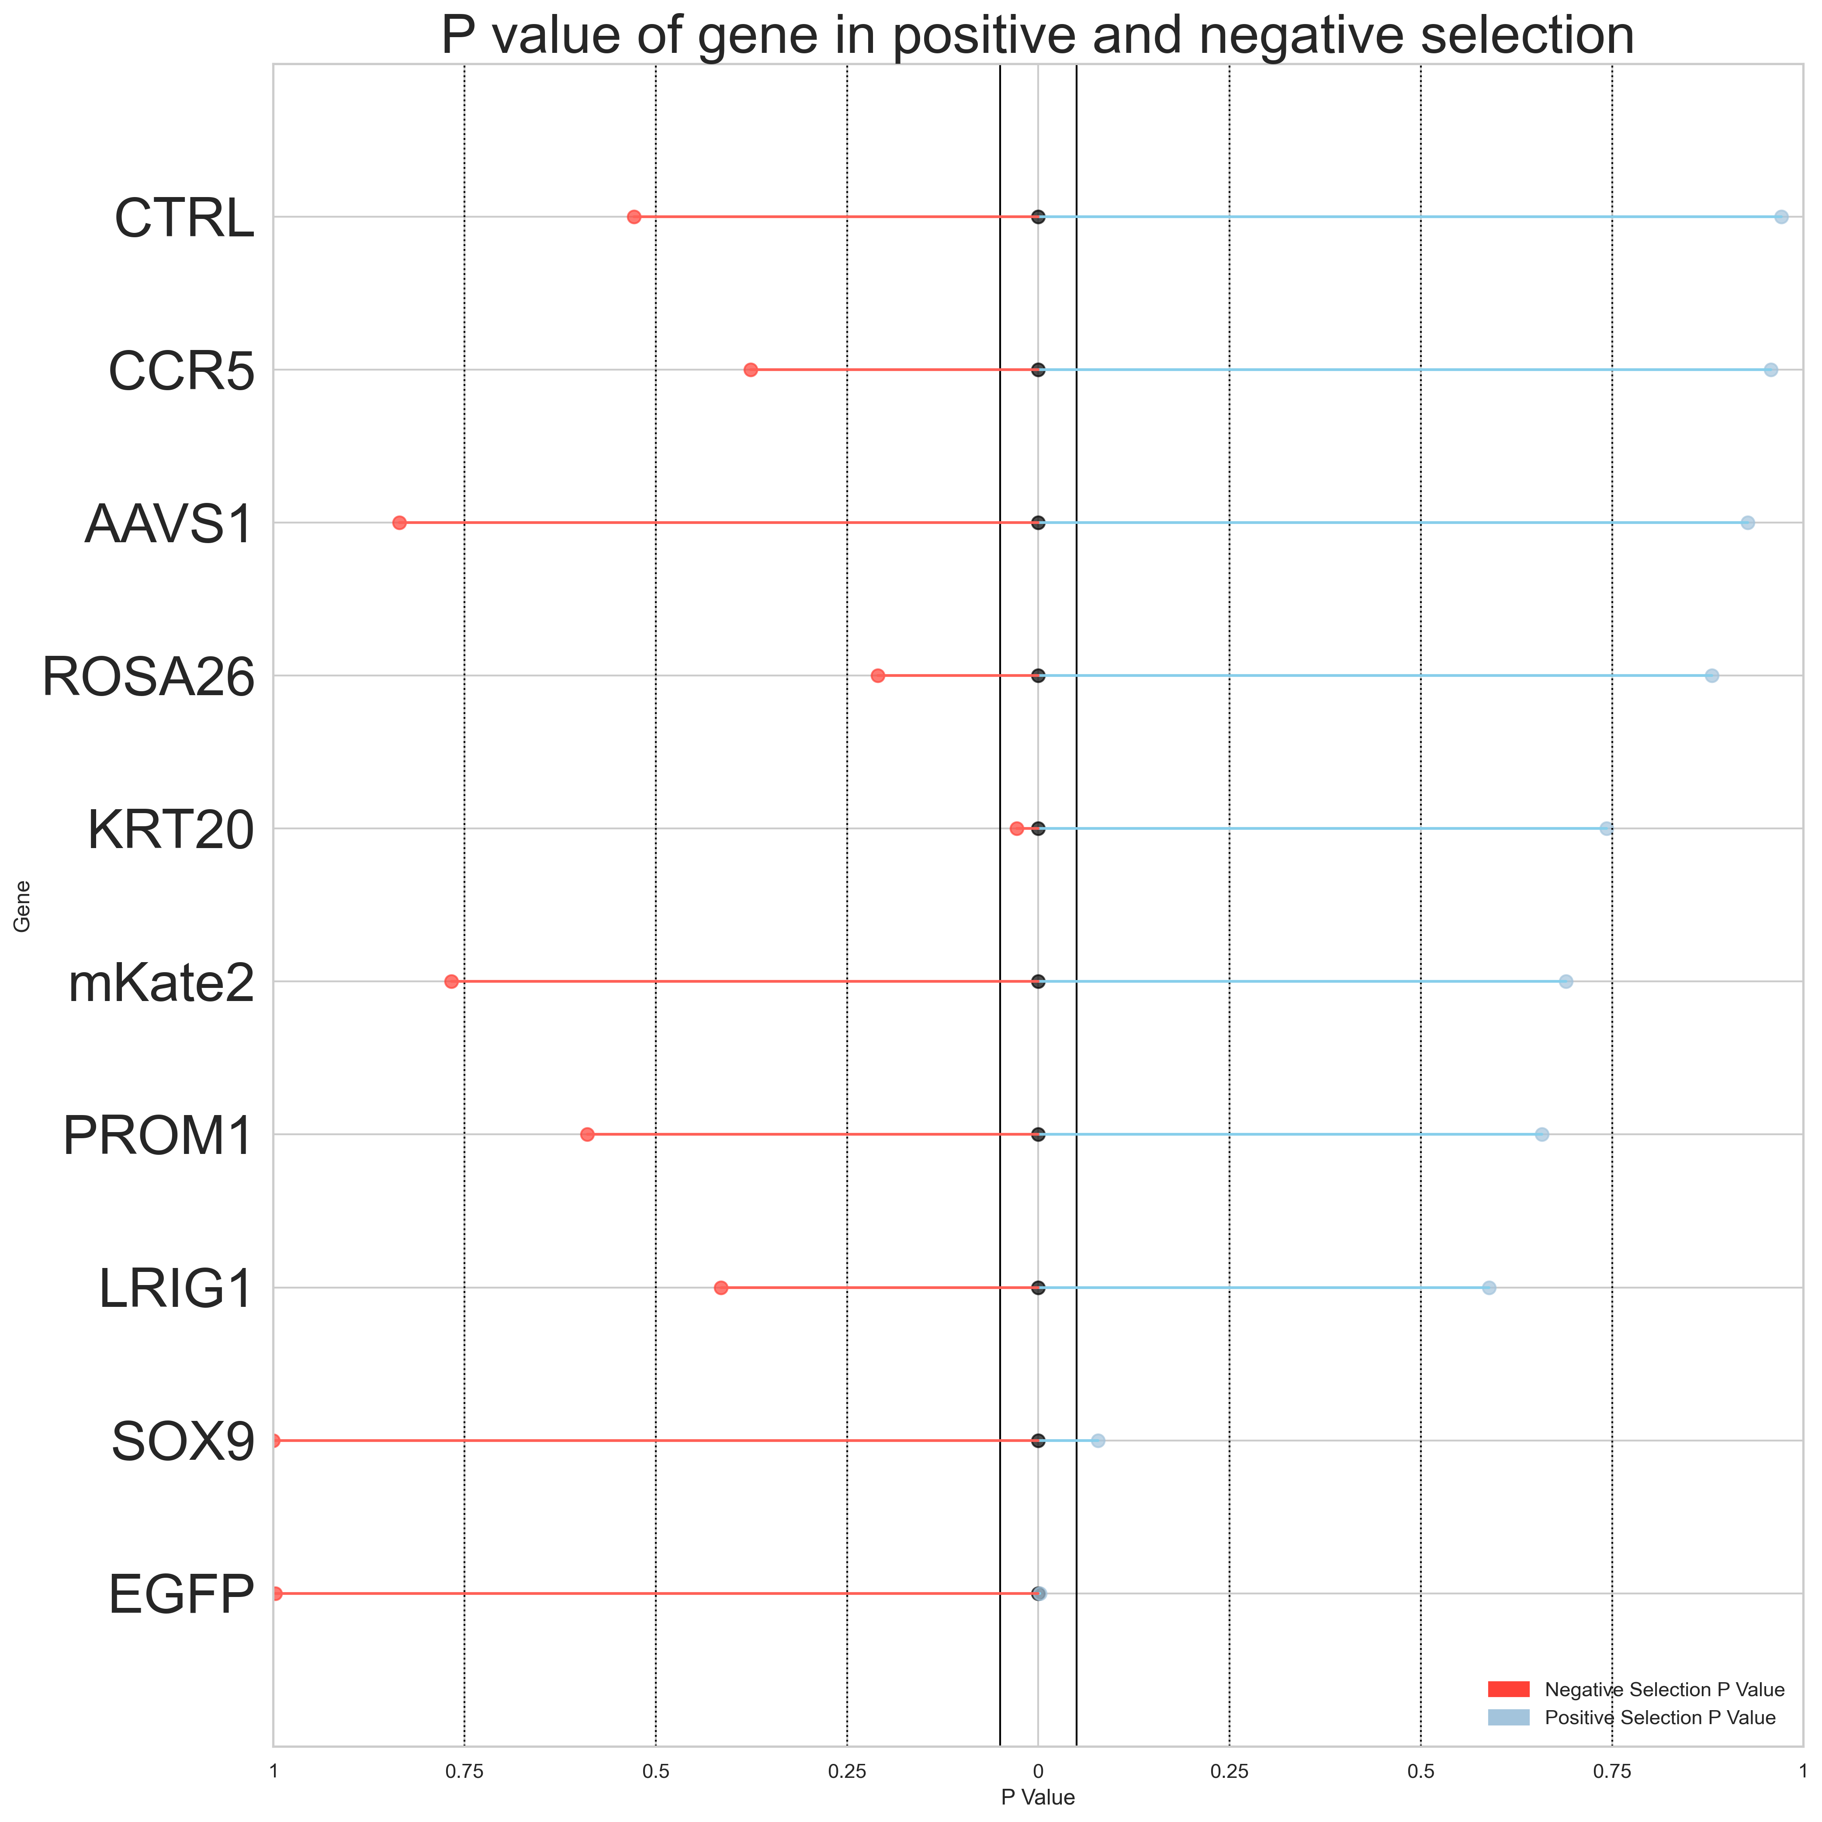
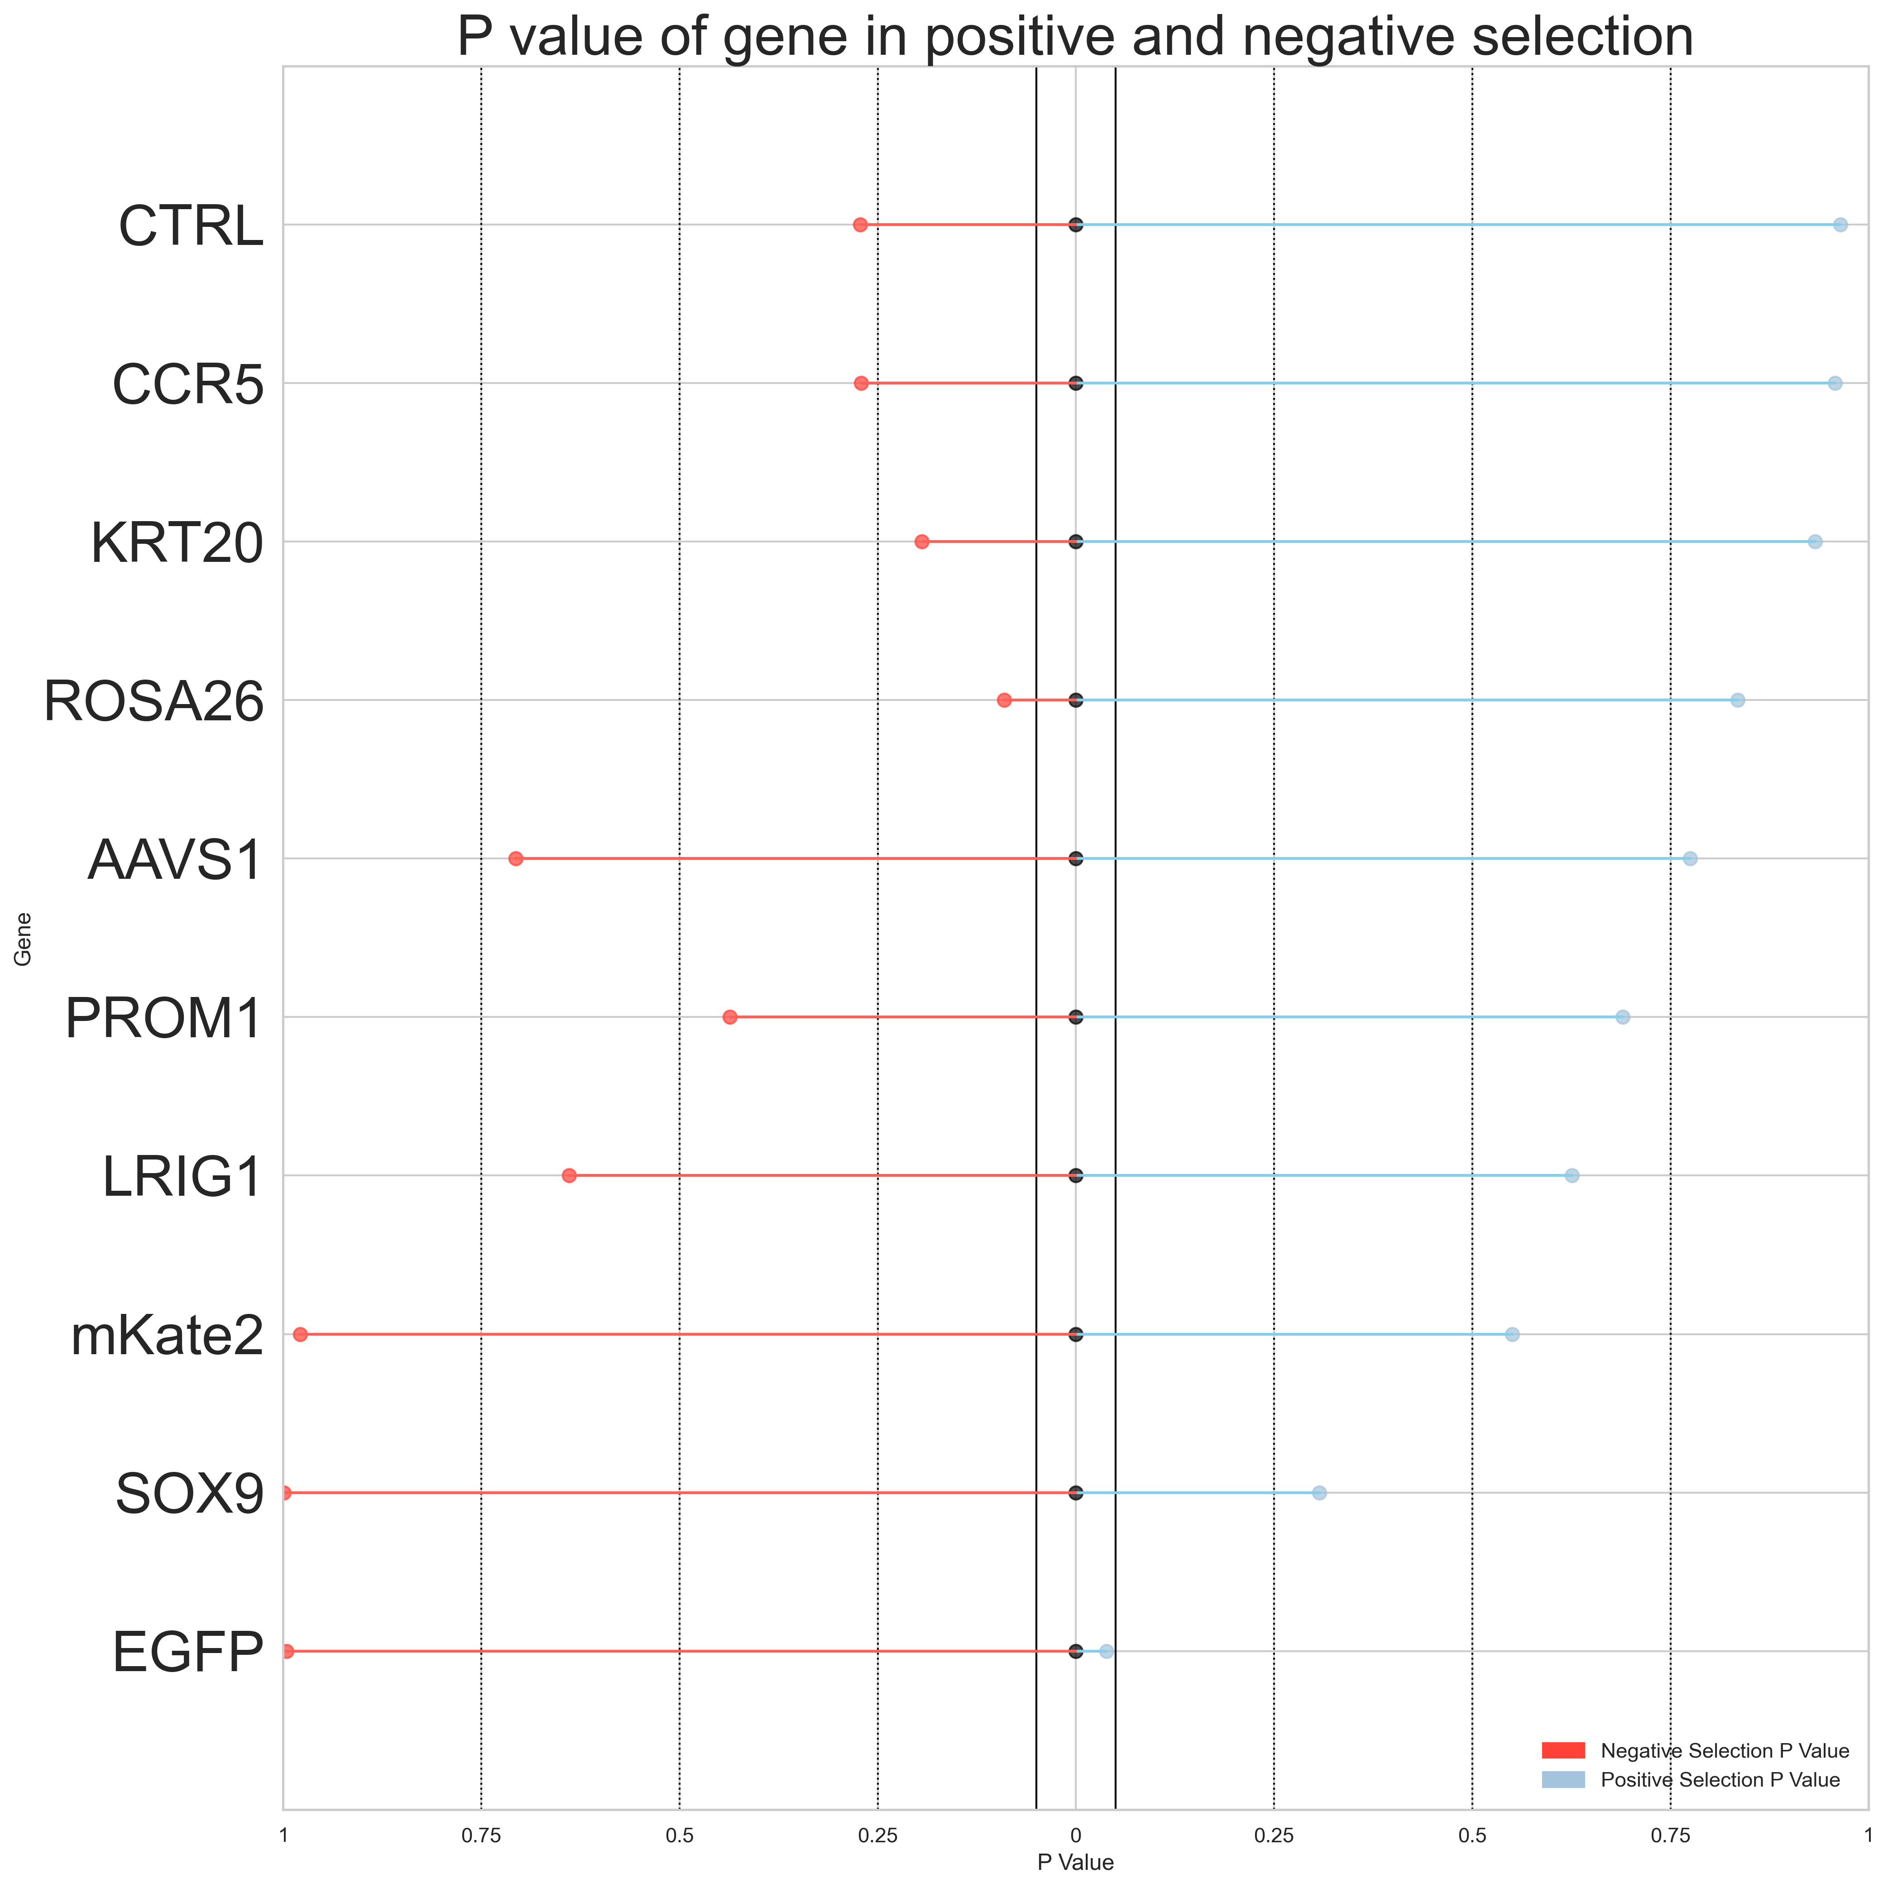
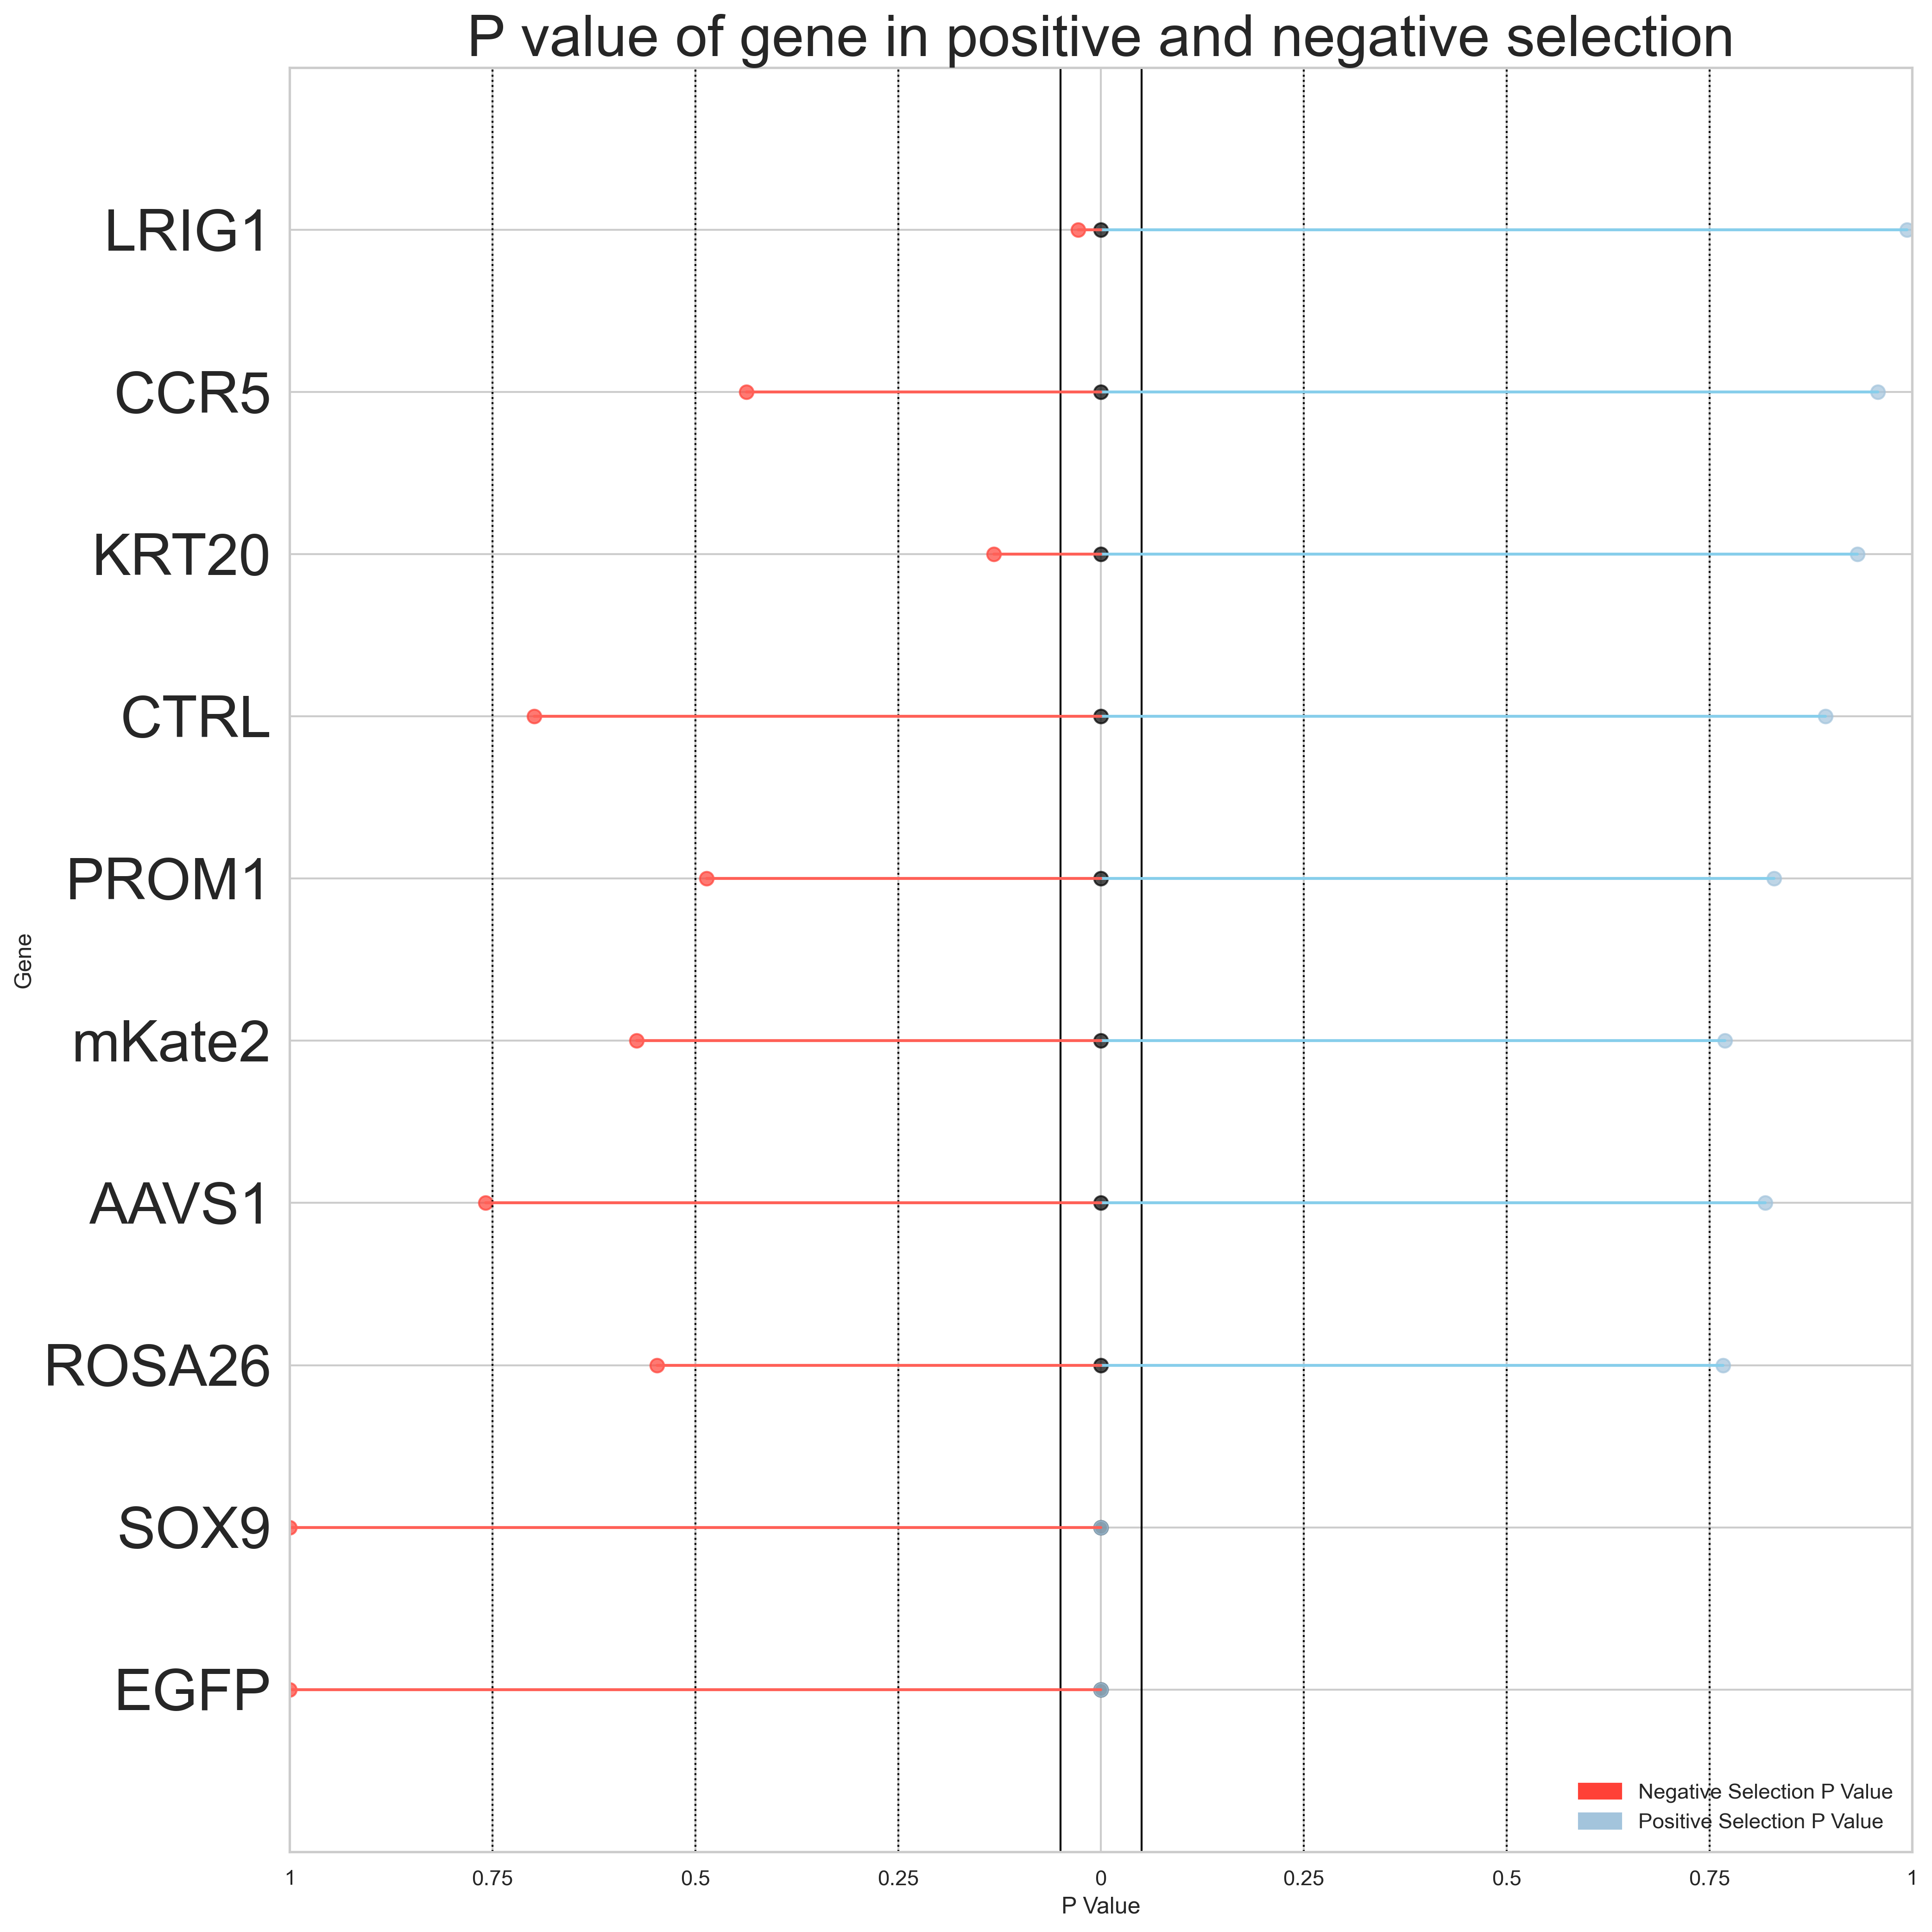
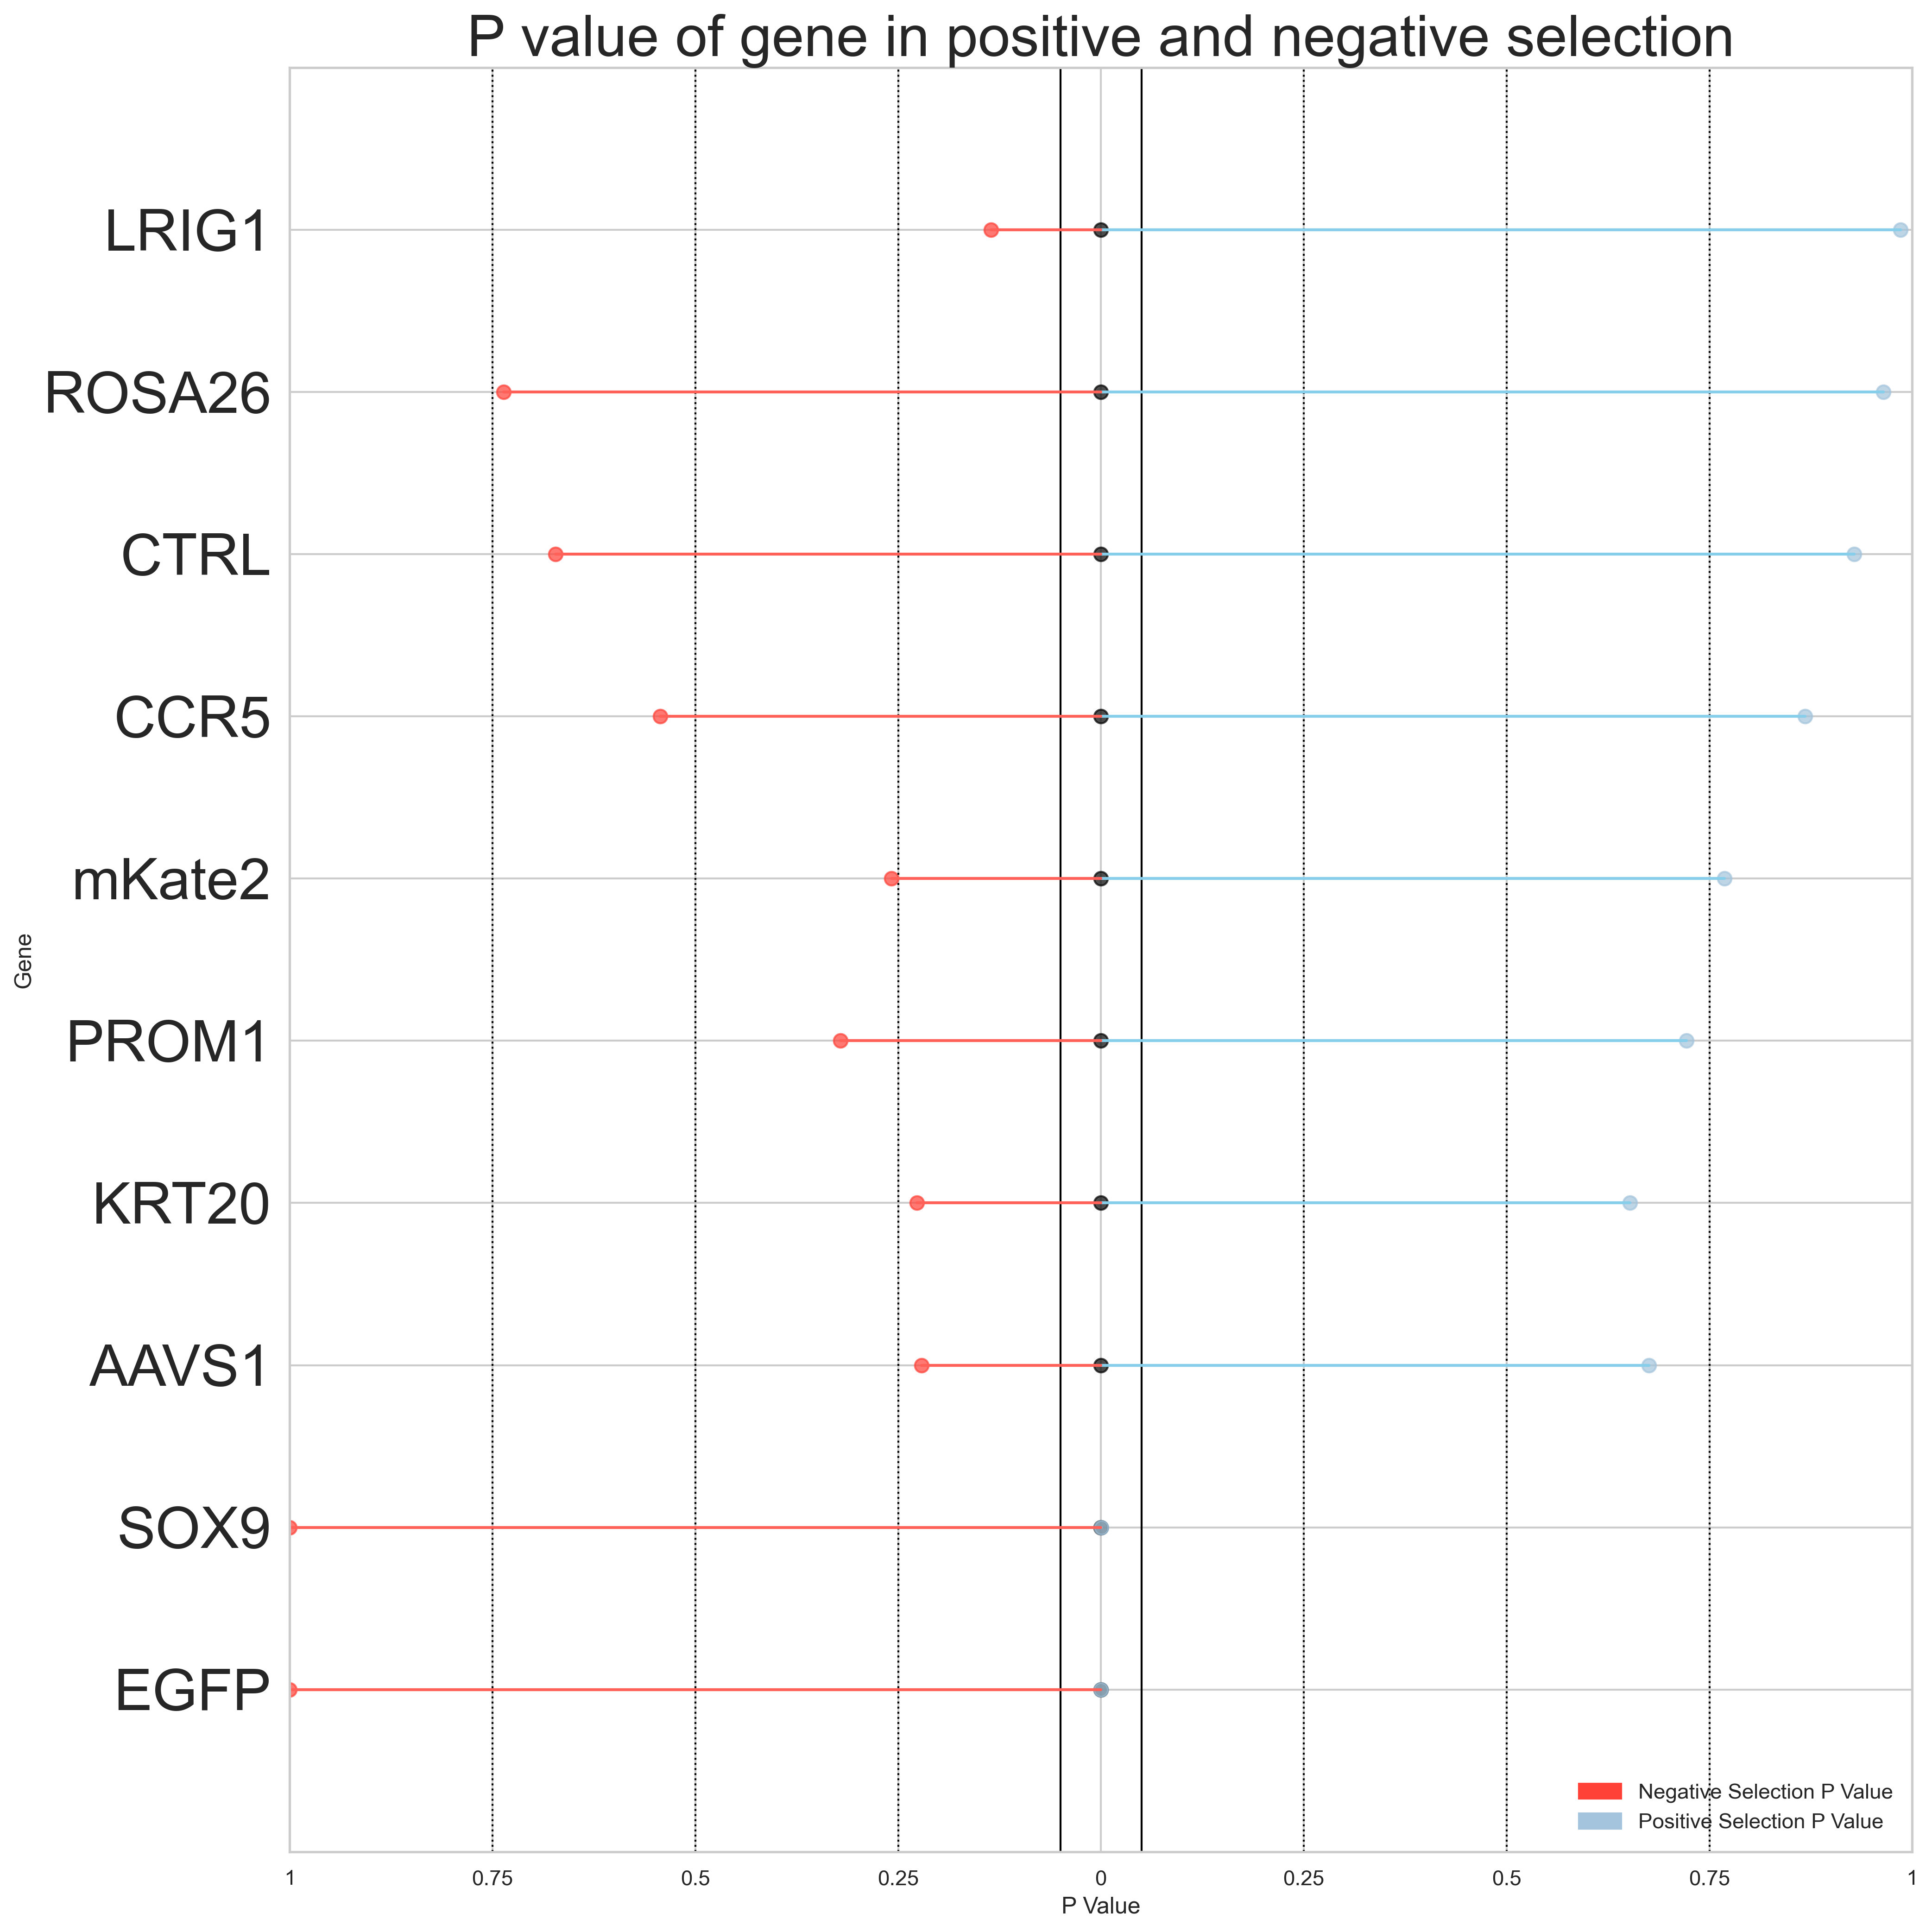
Introduction
Methods
Results
Discussion
Conclusion
Primer 3: LS180 SOX9 GFP
Top 2.5% vs Bottom 5%
Top 2.5% vs Bottom 2.5%
Day 3
Day 7
Day 3
Day 7
* Indicates P value < 0.05
*EGFP
*EGFP
*EGFP
*EGFP
*KRT20
*SOX9
*SOX9
*LRIG1

Slide 17
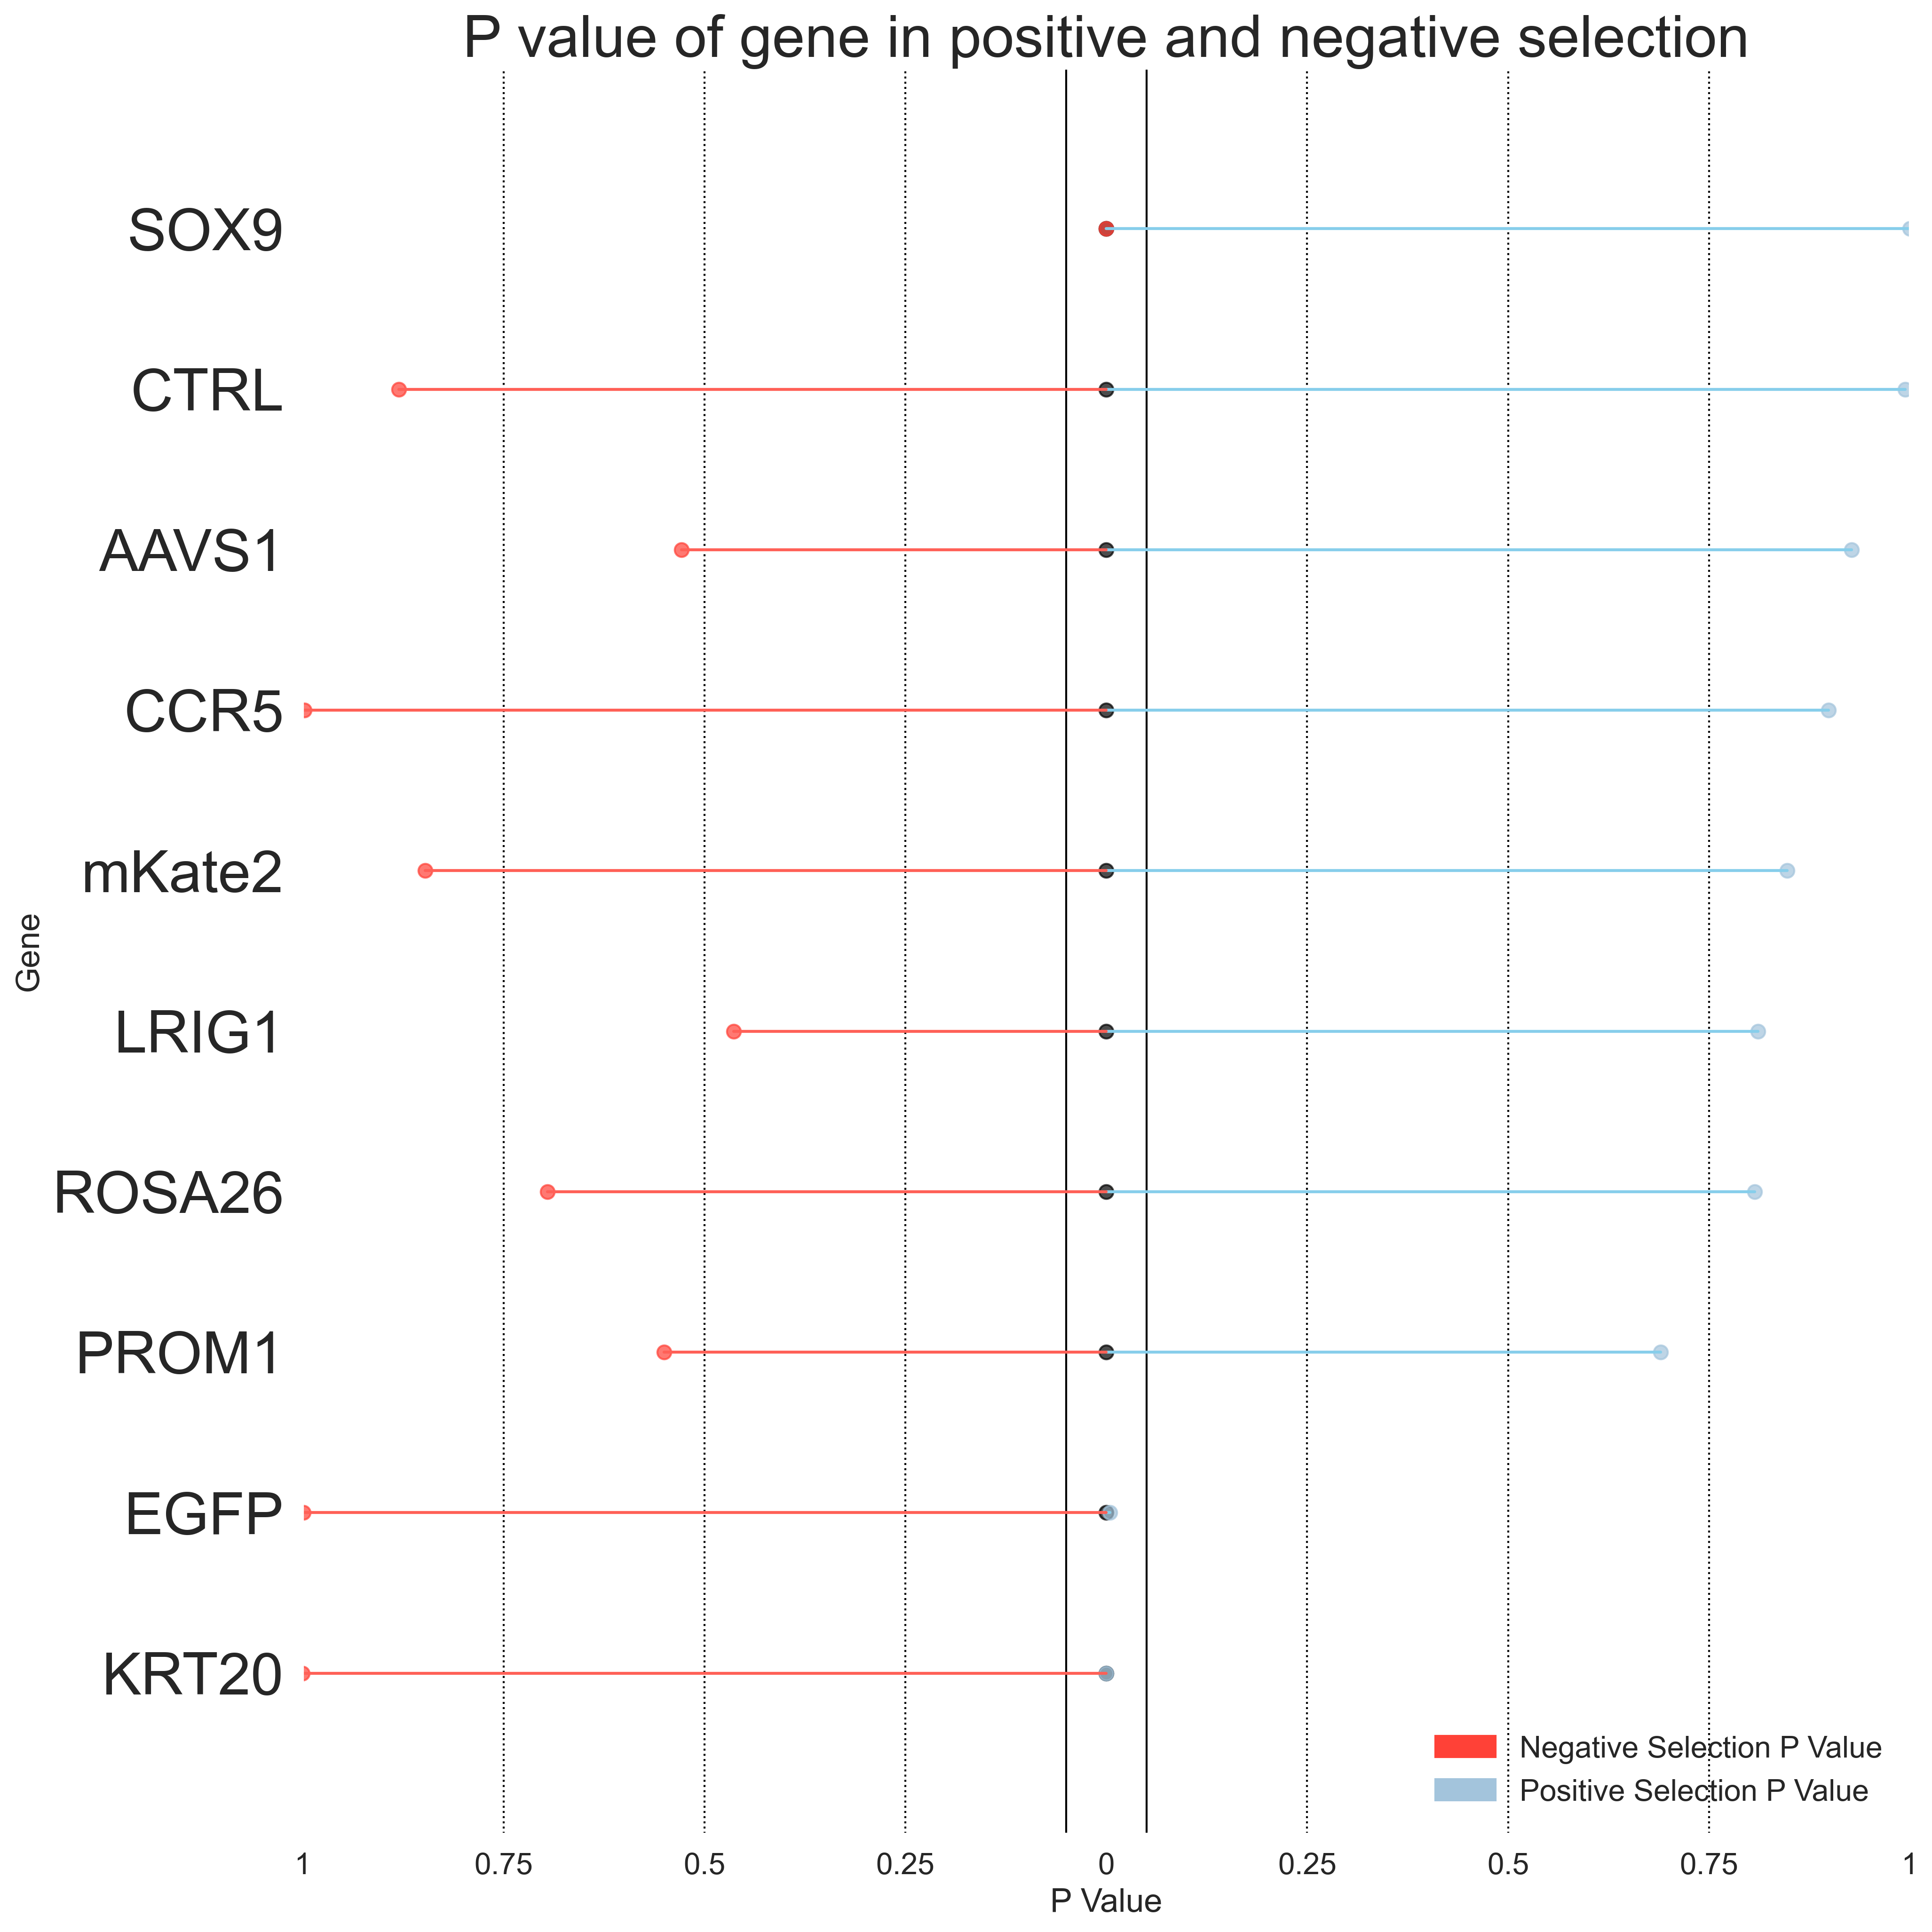
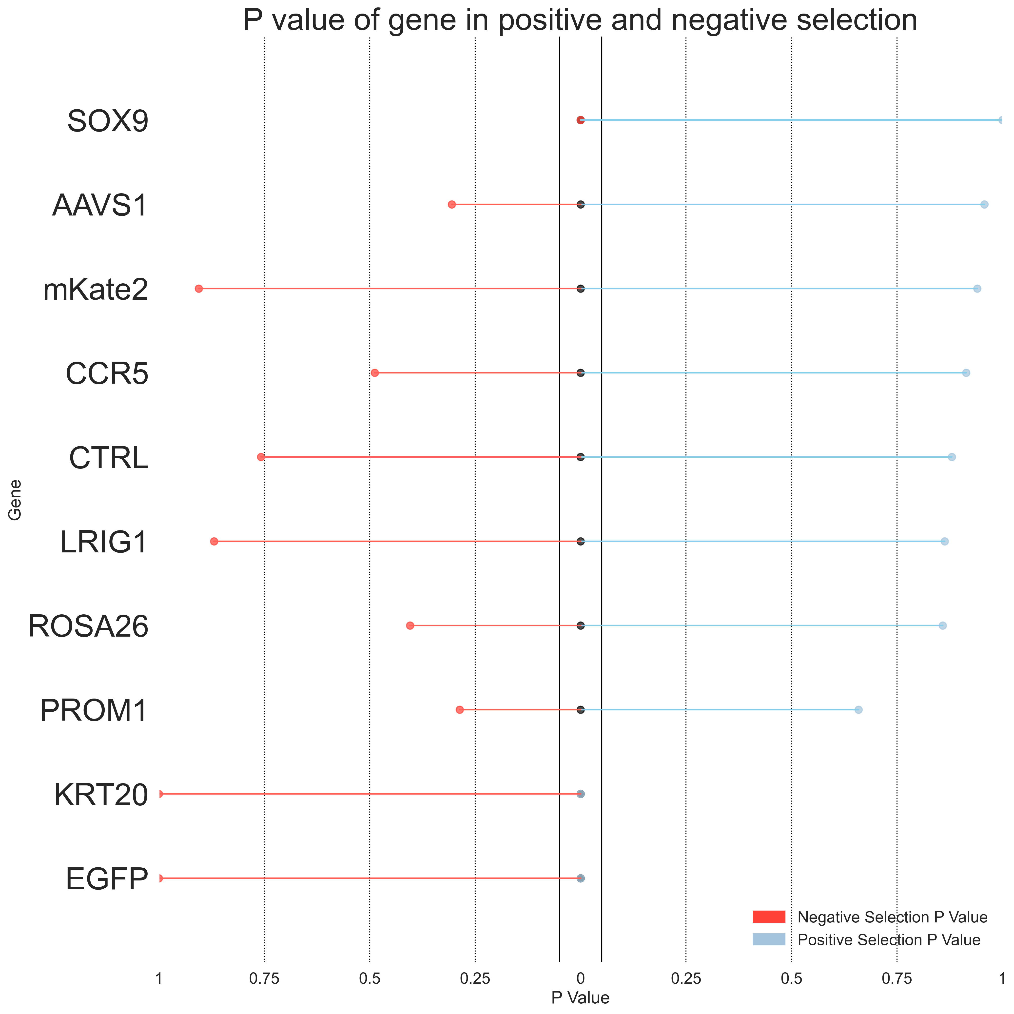
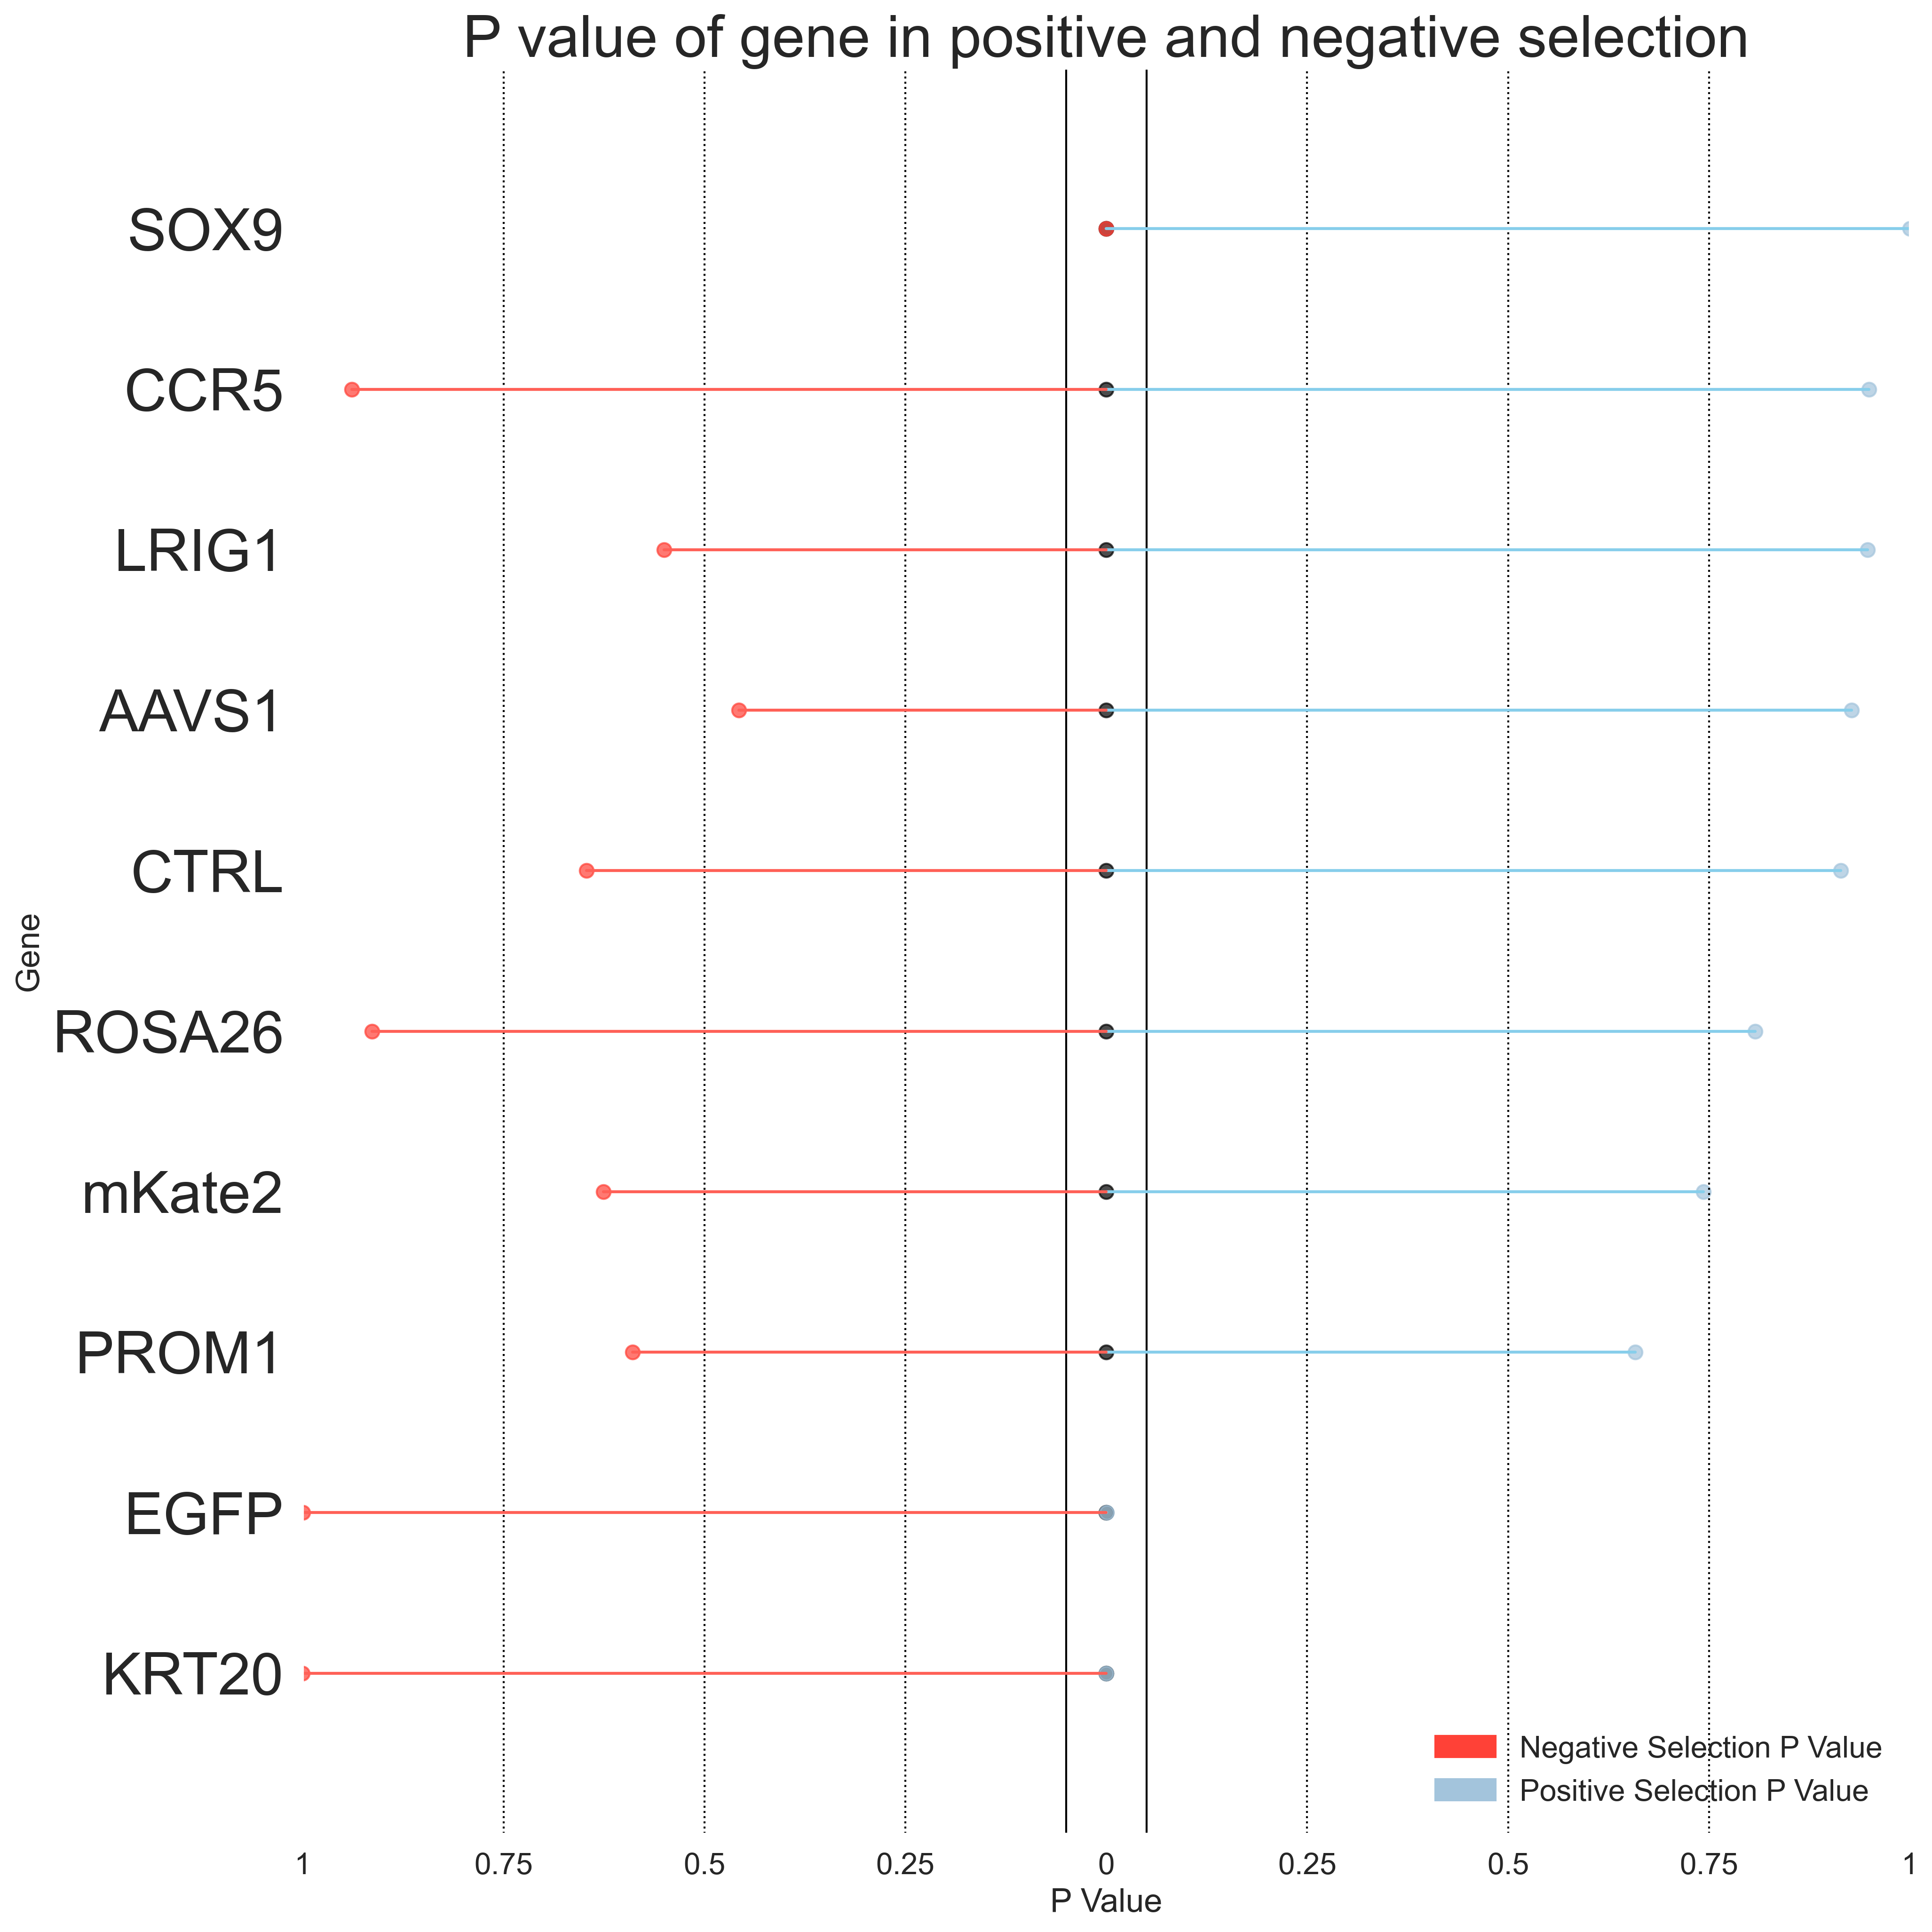
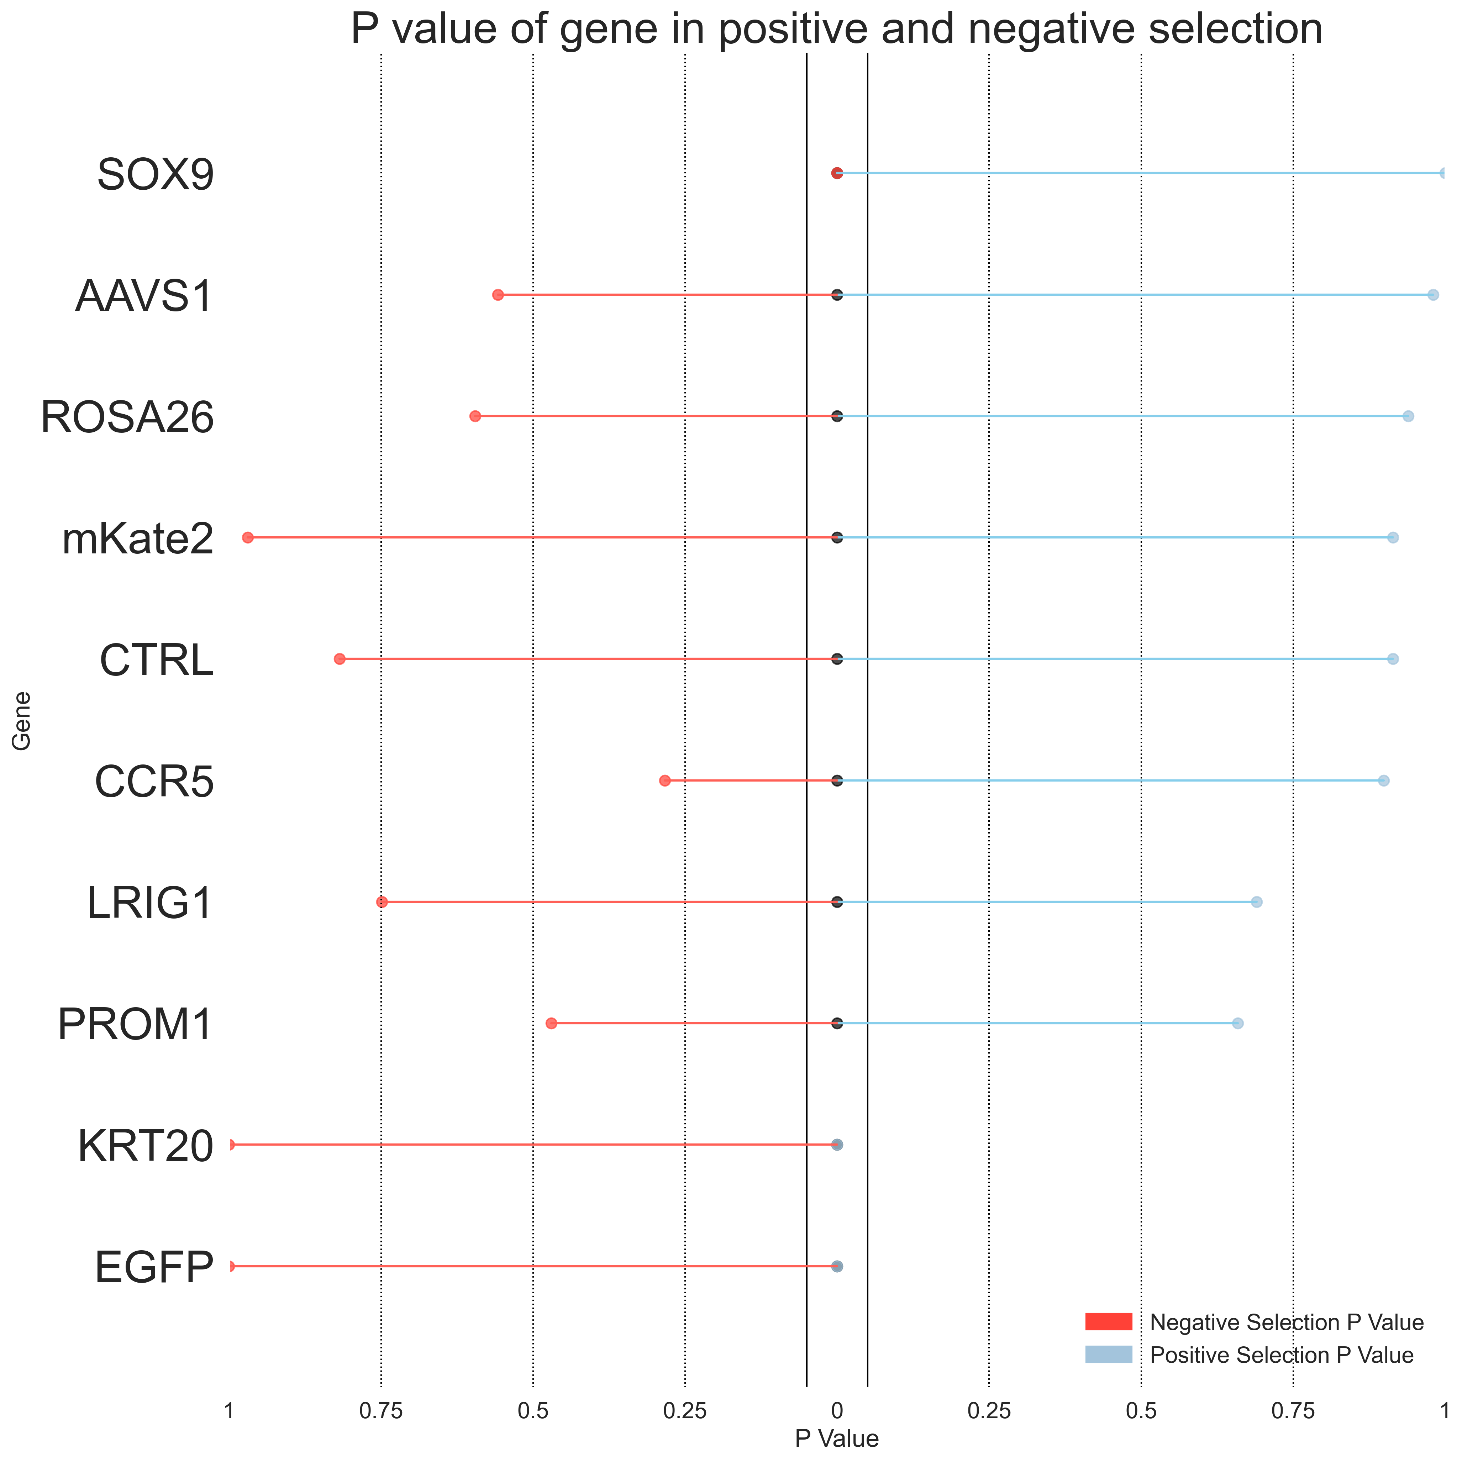
Introduction
Methods
Results
Discussion
Conclusion
Primer 4: HT-29 KRT20 GFP
Top 2.5% vs Bottom 5%
Top 2.5% vs Bottom 2.5%
Day 3
Day 7
Day 3
Day 7
* Indicates P value < 0.05
*EGFP
*EGFP
*EGFP
*EGFP
*KRT20
*KRT20
*KRT20
*KRT20
*SOX9
*SOX9
*SOX9
*SOX9

Slide 18
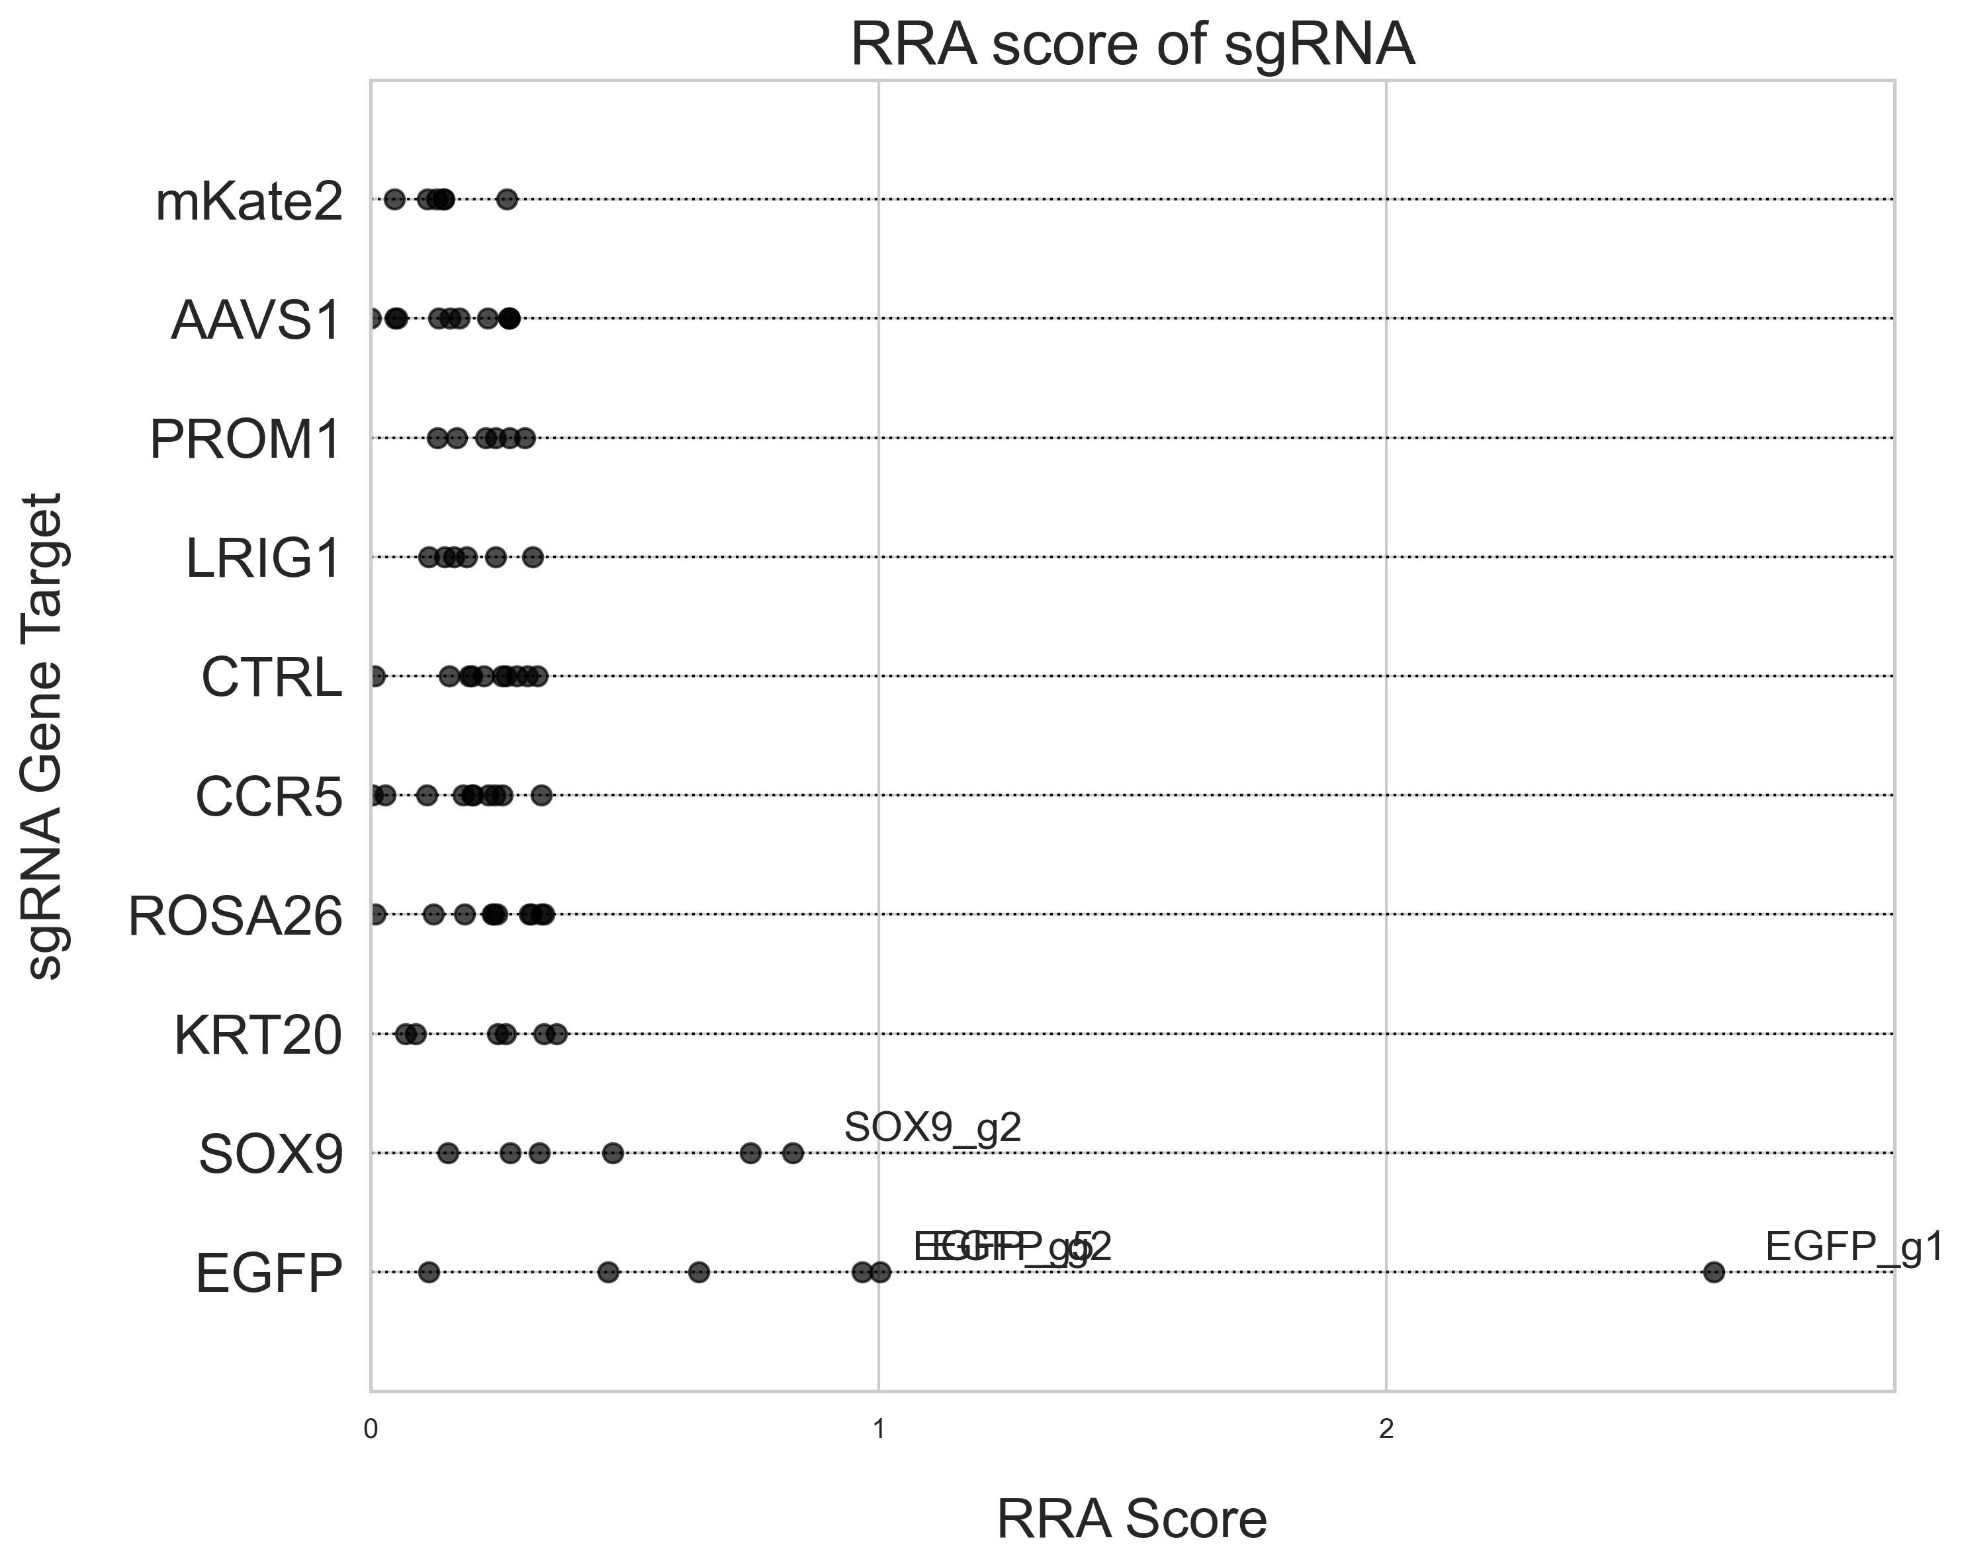
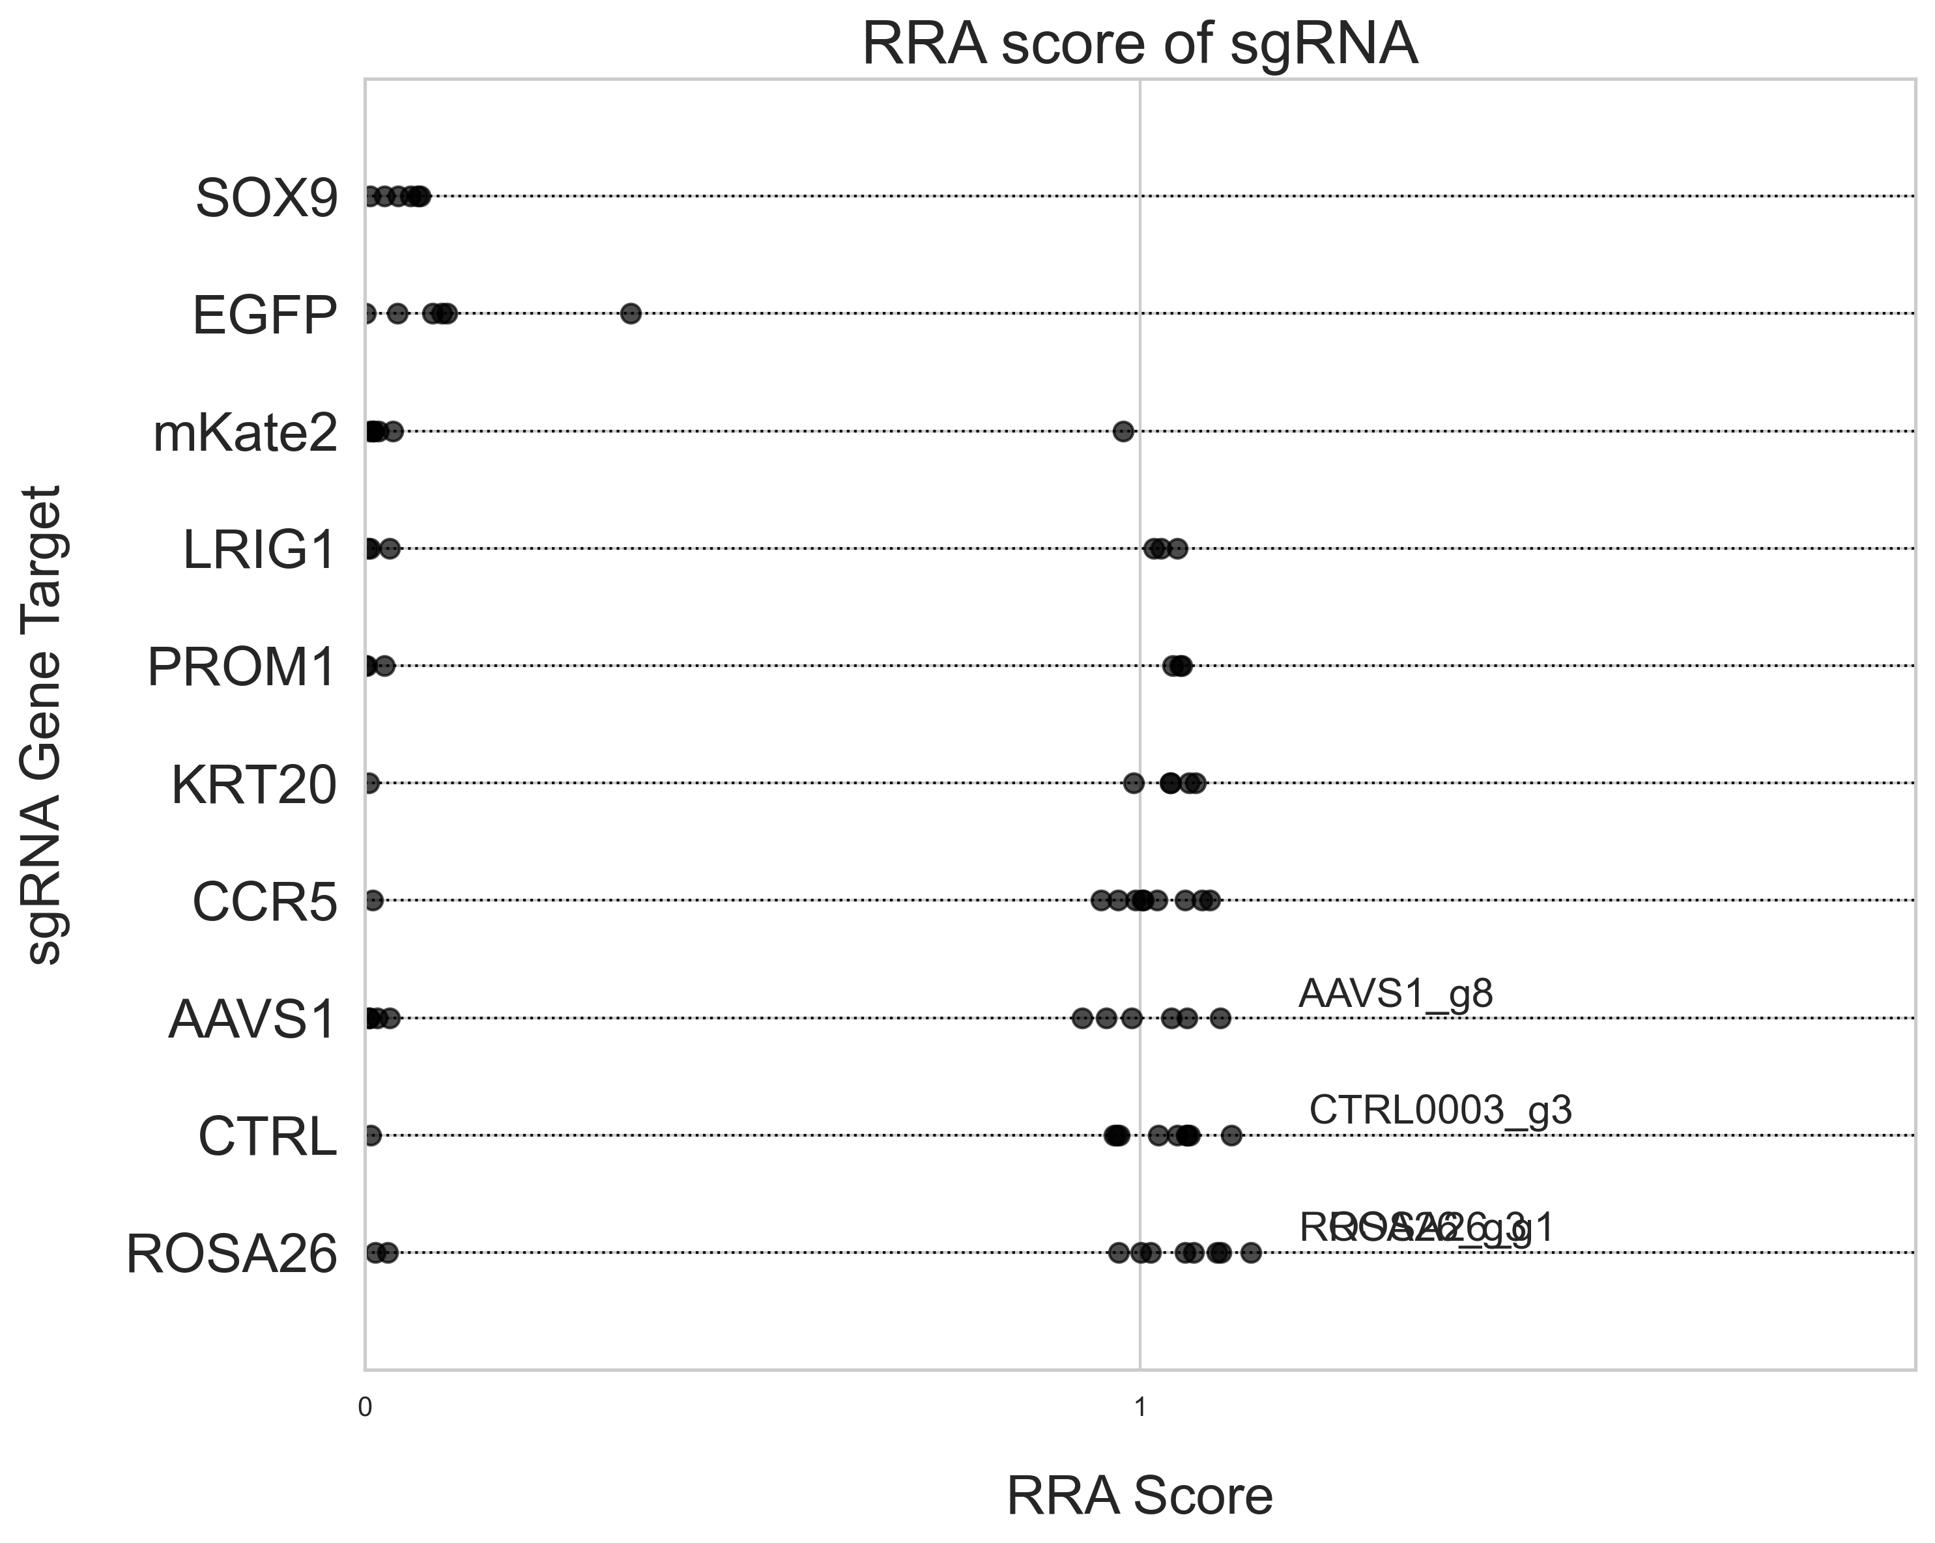
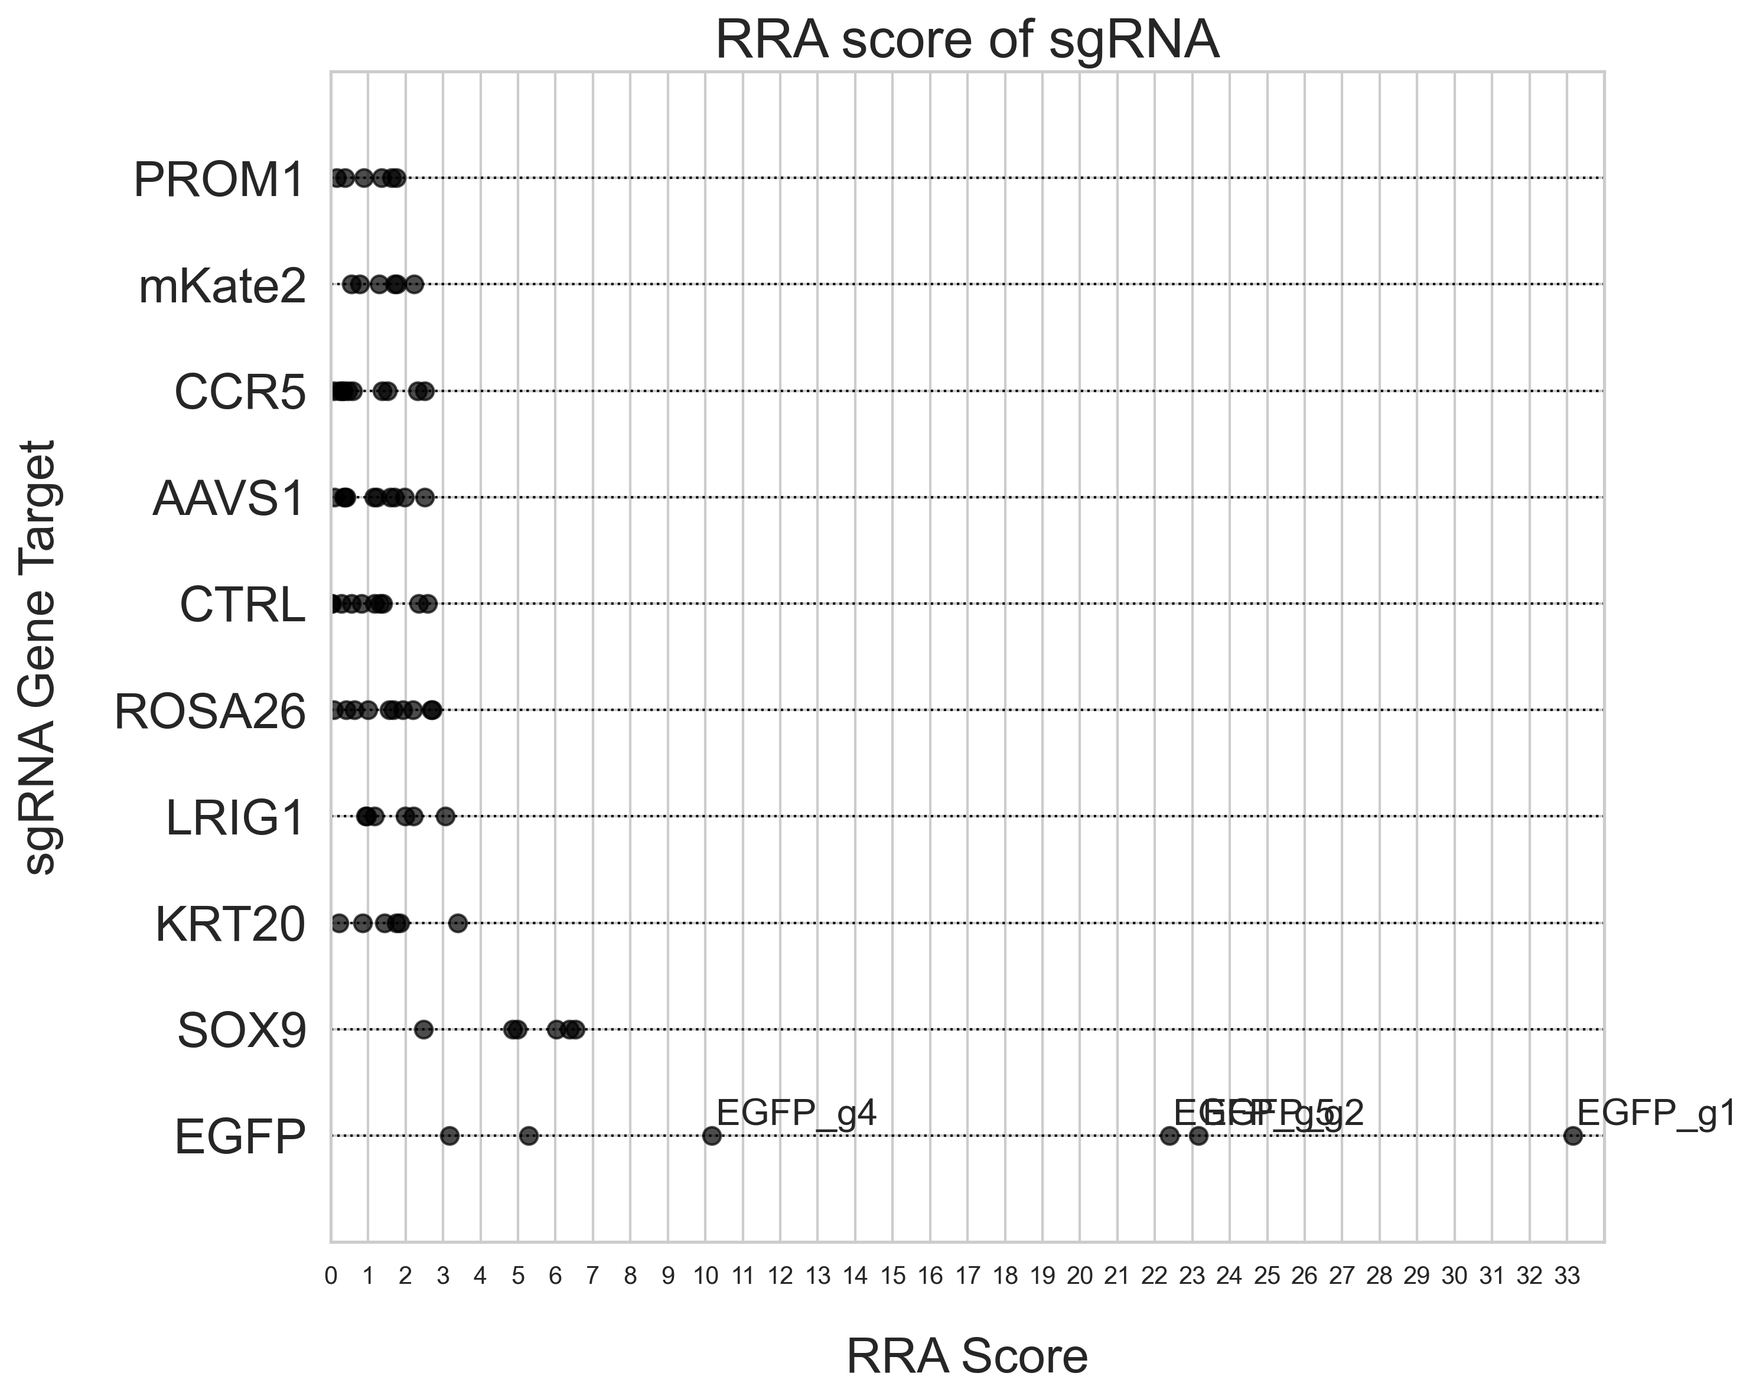

Introduction
Methods
Results
Discussion
Conclusion
Primer 3: LS180 SOX9 GFP RRA Score
Top 2.5% vs Bottom 5%
Top 2.5% vs Bottom 2.5%
Day 3
Day 7
Day 3
Day 7

Slide 19




Introduction
Methods
Results
Discussion
Conclusion
Primer 4: HT-29 KRT20 GFP RRA Score
Top 2.5% vs Bottom 5%
Top 2.5% vs Bottom 2.5%
Day 3
Day 7
Day 3
Day 7

Slide 20


Introduction
Methods
Results
Discussion
Conclusion
Primer 3: LS180 SOX9 GFP
Beta Score
Day 3
Day 7

Slide 21


Introduction
Methods
Results
Discussion
Conclusion
Primer 4: HT-29 KRT20 GFP
Beta Score
Day 3
Day 7

Slide 22




Introduction
Methods
Results
Discussion
Conclusion
LS180 SOX9 GFP Volcano Plot
Day 3
Day 7
Bottom 5%
Bottom 2.5%
Bottom 5%
Bottom 2.5%

Slide 23




Introduction
Methods
Results
Discussion
Conclusion
HT-29 KRT20 GFP Volcano Plot
Day 3
Day 7
Bottom 5%
Bottom 2.5%
Bottom 5%
Bottom 2.5%

Slide 24
Introduction
Methods
Results
Discussion
Conclusion
Bottom 2.5% Fraction or Bottom 5% Fraction
Primer 3: LS180 SOX9 GFP at Day 7
Primer 4: HT-29 KRT20 GFP at Day 7

Slide 25
Introduction
Methods
Results
Discussion
Conclusion
Day 3 vs Day 7
Primer 3: LS180 SOX9 GFP at Day 7
Primer 4: HT-29 KRT20 GFP at Day 7

Slide 26
Introduction
Methods
Results
Discussion
Conclusion
HT-29 vs LS180
Primer 3: LS180 SOX9 GFP at Day 7
Primer 4: HT-29 KRT20 GFP at Day 7

Slide 27
Introduction
Methods
Results
Discussion
Conclusion
Conclusion
Comparing the Top 5% and Bottom 5% Fractions (separated based on GFP intensity) consistently produced representative and expected results for enrichment and depletion of target RNA read counts.
Day 7 consistently produced expected results with greater magnitude of fold change and scoring metrics as well as improved statistical confidence (p<0.05) compared to Day 3.
HT-29 cell line produced expected enrichment and depletion of target RNA read counts with fewer off-target effects compared to the LS180 cell line.

Slide 28
Introduction
Methods
Results
Discussion
Conclusion
Further Directions
Finalize analytical and visualization pipeline
Benchmark the dual-reporter system compared to the single-channel system
Comparison of the efficacy of gRNA vs shRNA to produce targeted enrichment and depletion

Slide 29

Introduction
Methods
Results
Discussion
Conclusion
Primer 1: shRNA
Day 3: Top 2.5%
Day 3: Top 5%
Day 3: Bottom 5%
Day 3: Bottom 2.5%
Day 7: Top 2.5%
Day 7: Top 5%
Day 7: Bottom 5%
Day 7: Bottom 2.5%
Day 3
Day 7

Slide 30




Introduction
Methods
Results
Discussion
Conclusion
Primer 1
Top 2.5% vs Bottom 5%
Day 3
Day 7

Slide 31




Introduction
Methods
Results
Discussion
Conclusion
Primer 1
Top 2.5% vs Bottom 2.5%
Day 3
Day 7

Slide 32




Introduction
Methods
Results
Discussion
Conclusion
Primer 1
Top 2.5% vs Bottom 5%
Top 2.5% vs Bottom 2.5%
Day 3
Day 7
Day 3
Day 7
* Indicates P value < 0.05
*SOX9
*SOX9
*EGFP
*SOX9
*CCR5
*KRT20
*TCF4
*EGFP
*GFP

Slide 33




Introduction
Methods
Results
Discussion
Conclusion
Primer 1: RRA Score
Top 2.5% vs Bottom 5%
Top 2.5% vs Bottom 2.5%
Day 3
Day 7
Day 3
Day 7

